Slide 1
Big Data and Analytics Systems:
Computer System Architecture 1
Fayé A. Briggs, PhD
Adjunct Professor and Intel Fellow(Retired)
Rice University
Material mostly derived from “Mining Massive Datasets” from:
Jure Leskovec, Anand Rajaraman, Jeff Ullman Stanford University
http://www.mmds.org

Slide 2
Big Data Driving Memory Bandwidth & Capacity
Codes Based on Analytic Models
Codes Based on Data Driven Models
Well Known HPC Workloads
New Big Data Workload
HPC Today
HPC Tomorrow
Compute Focused
Minimizes Data Movement
I/O predominantly For Checkpoints
Datasets are ~Megabytes
Data for compute is sampled or generated
I/O Focused
Lots of Data Movement
I/O predominantly for storing and retrieving data
Datasets are ~Petabytes
All data is needed all the time
System Design Points Are Changing!

Slide 3
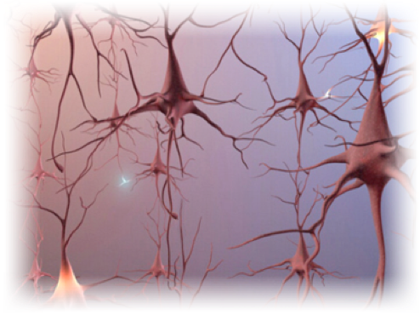




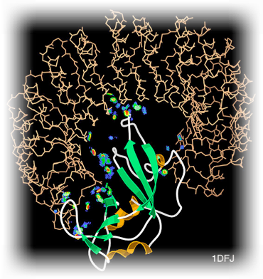
Expanding Usage Models
Our Collective Future Lies Here
Human Brain
Social Network
Internet
100B Neuron
100T Relationships
1B Users
140B Friendships
1 Trillion Pages
100s T Links
e-commerce
Online Services
Science
Millions of Products
and Users
27M Users
70K Movies
Large Biological
Cell Networks
How Do We Evolve … To Our Next Frontier?

Slide 4
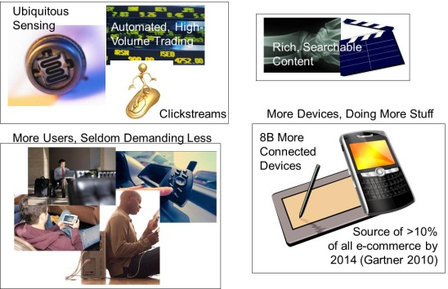

‘In-Memory Computing’
Self-defining, structured content:
Generates
Subject | Predicate | Object
Sensor | HasID | “123”
Sensor123 | HasTimeStamp | 12:03:45
Sensor12312:03:45 | HasValue | 127psi
“The Semantic Web” – Graph-oriented databases, RDF-based standards, etc.
Rules engines, Bayesian Belief Networks, Human-assisted analyses
Insight Leading To (Correct, High-Value) Action
Millions of objects
Billions of events
Random data access
You just can’t do this in time to be useful
unless everything’s in-memory

Slide 5
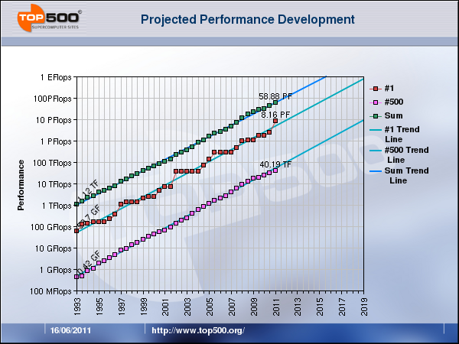
Trends to Exascale Performance
33.9PF Tianhe-2
Getting to Exascale within 20-40MW by 2020 Requires a Performance Improvement of 2x every year

Slide 6




Cores & Uncores: Performance Drivers
EP, WS 2S
DDR3
QPI
DDR3
Core
DDR3
Xeon 2600
Xeon 2600
DDR3
C
O
R
E
C
O
R
E
C
O
R
E
SNB
Core
SNB
Core
…
DDR3
QPI
DDR3
DDR3
DDR3
PCIe
x8
PCIe
PCIe
PCIe
PCIe
PCIe
PCIe
PCIe
PCIe
ESI
ESI
PCIe
Shared Last Level Cache
DRAM
Uncore
…
Memory Controller
QPI
QPI
Power &
Clock
PCIe
Memory
NHM-EX
NHM-EX
…
QPI
Shown: Xeon 2600 Architecture
Memory
NHM-EX
NHM-EX
Intel® QPI
IOH
IOH
ICH10
PCI Express* Gen2
PCI Express* Gen2

Slide 7
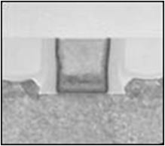
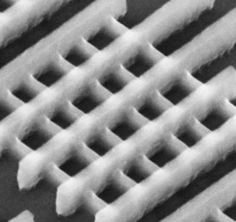
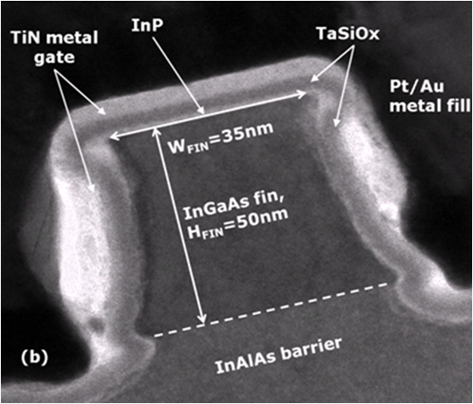
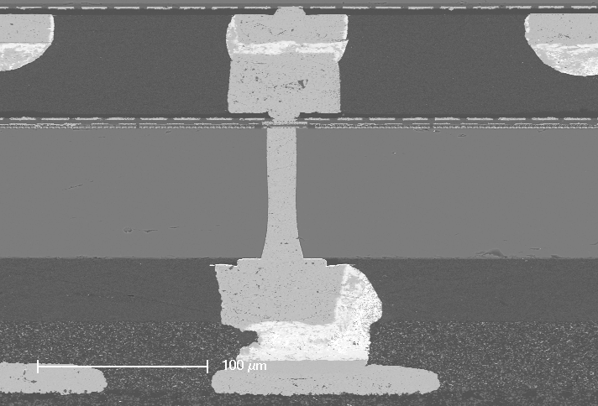
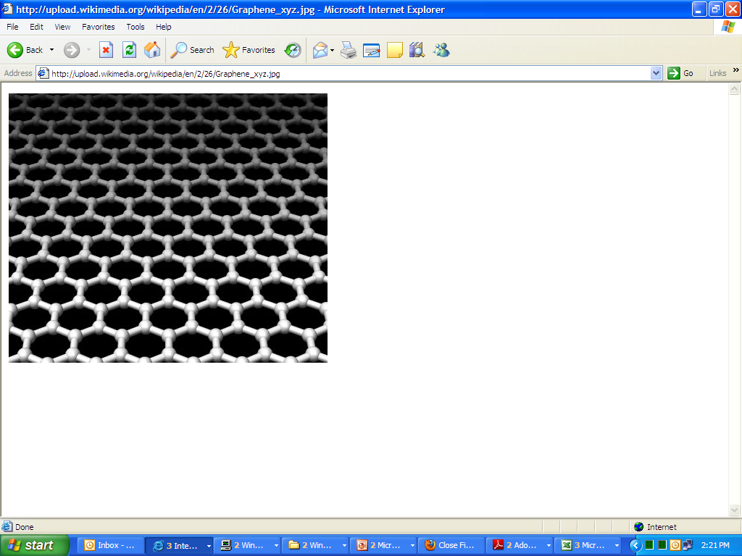
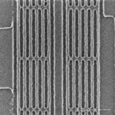
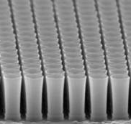
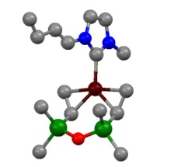
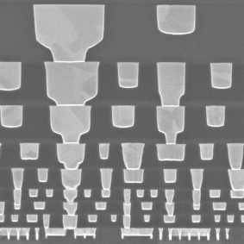
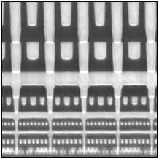
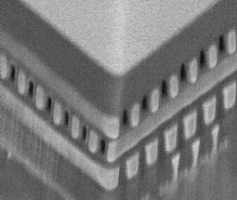
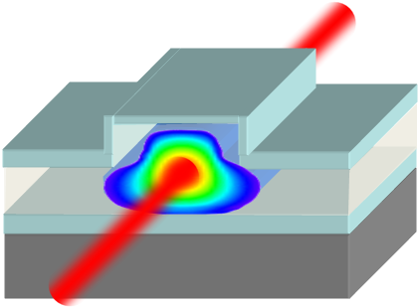
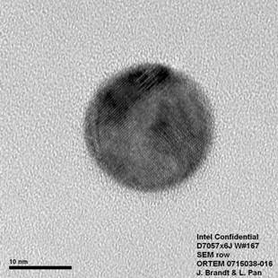
Moore’s Law Is Alive & Well
32 nm 22 nm 14 nm 10 nm 7 nm 5 nm
2009 2011 2013 2015+
III-V
3-D
Graphene
EUV
Dense Memory
Materials
Synthesis
Interconnects
Photonics
Nanowires
Future options subject to change
Going forward, scaling will be as much about
material and structure innovation as dimensional scaling

Slide 8
Micro-architecture Performance Parameters
Core capability (Instructions Per Cycle)
Vector FLOP Density
Core-count
On-die Interconnect
Frequency
Cache Hierarchy
Memory Latency
Memory bandwidth & Size
Memory Technologies
Performance = Frequency * Instructions Per Cycle (IPC)
Frequency α voltage,
so frequency reduction coupled with voltage reduction results in cubic reduction in power.
Power α V * V * Frequency
  Many Knobs for Optimizing Performance within Power & Costs Constraints

Slide 9
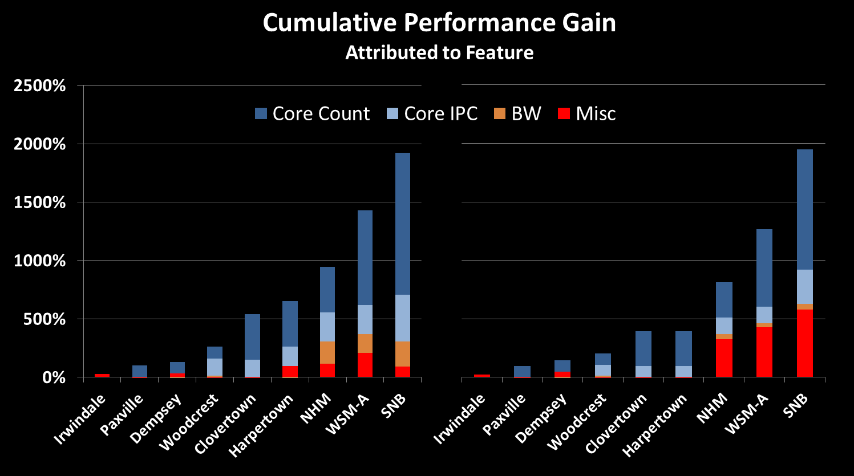
Cumulative Performance Drivers
SPECint Rate
TPC-C
Core-count & IPC primarily drive cumulative performance increases provided adequate memory bandwidth

Slide 10
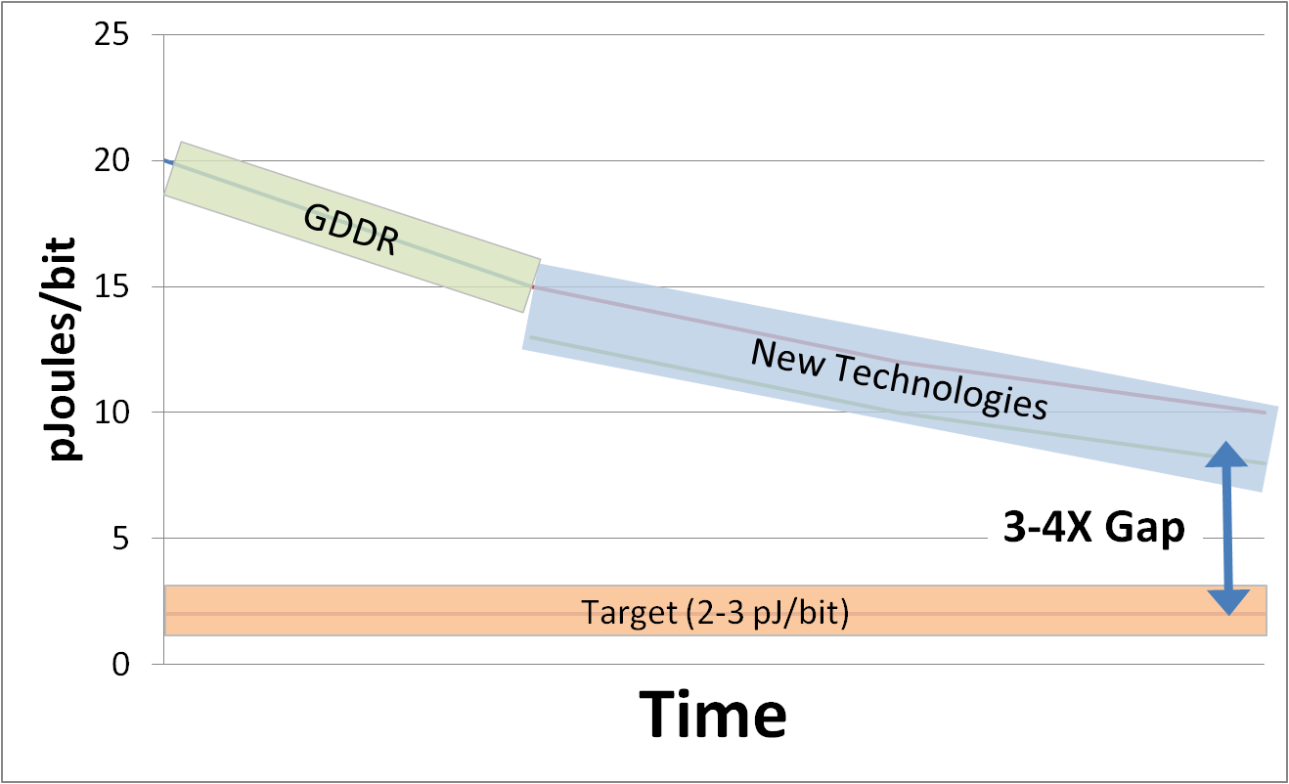
Memory Power Challenges
Memory bandwidth is critical to HPC performance
Need to balance bandwidth with capacity and power
1 ExaFlop Machine
→ ~200-300 PB/sec
→ ~2-3 pJ/bit
GDDR will be out of steam
Periphery connected solutions will run into pincount issues
Existing technology trends leave 3-4x gap on pJ/bit
Notes:
Assume 0.2-0.3 Byte/Flop ratio for BW
1 ExaFlop → 200 – 300 PB/sec BW @ 0.2-.3 Byte/Flop
Nehalem had 0.4 B/F ratio. Huge success in this regard.
Assuming 100K nodes, need 2-3 TB/sec per node
@ 50W budget → 2-3 pJ/bit

Slide 11
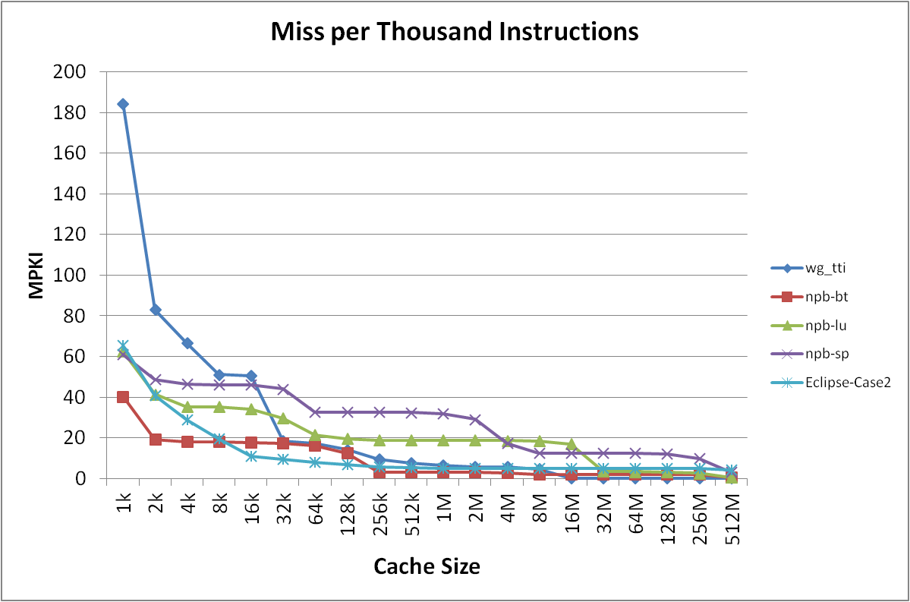
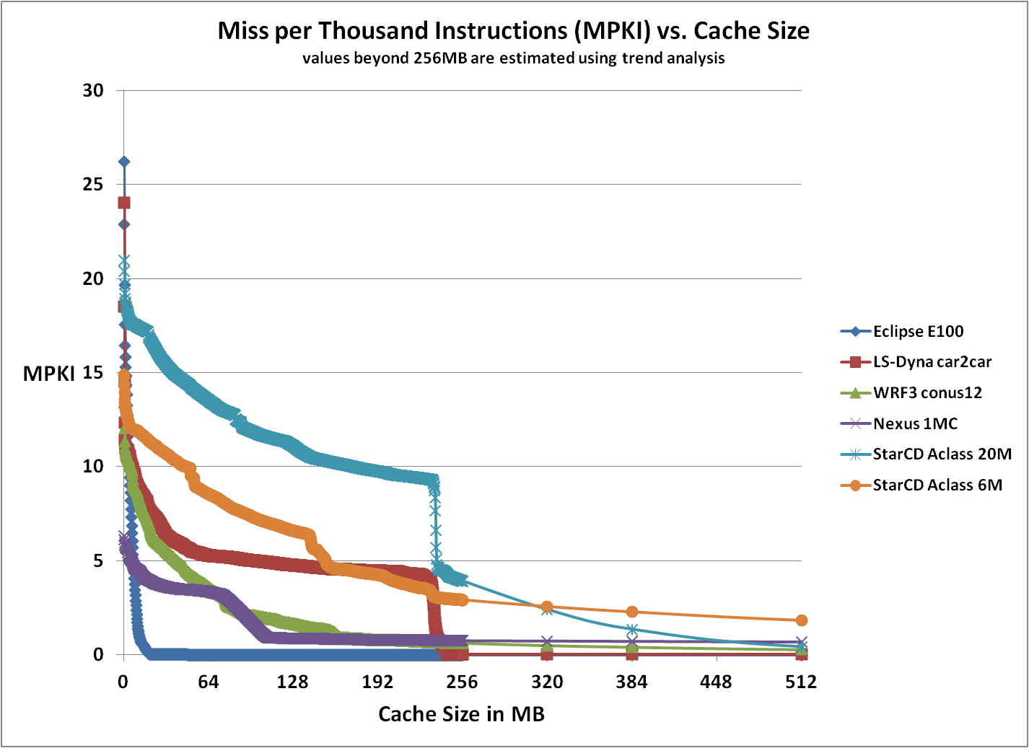
Role of Caches in HPC Workloads
MPKI
MPKI
Most HPC workloads benefit from caches
Less than 20 MPKI for 1M-4M caches
Caches help to reduce memory bandwidth demand and power

Slide 12
Peak Memory Bandwidth
CPU Integrated MCs
MCH based MCs
3ch
4C
4ch
8C
4ch
8+C
Downward trend of peak BW/core as core count increased
Sustainable bandwidth per core is even worse
Traditional approach is adding more channels (expensive)
  ~20% CAGR from data rate
  ~15% CAGR on channel count and burst length
Intel estimates of future trends in bandwidth capability, memory channels and core count. Intel estimates are based in part on historical Intel products and projections. Actual bandwidth capability, core count and number of channels of Intel products will vary based on actual product configurations.

Slide 13
DDR BW has doubled every 2 years for 12 years
(0.5 → 1 → 2 → 4ch
200 → 400 → 800 → 1600 Mbps)
Growing gap
No sustainable DDR BW growth
Server memory bandwidth growth has hit a wall

Slide 14

Three “DRAM Walls”
Process Scaling Wall
Bandwidth Wall
Scaling Wall
Power Wall
Reliability Wall
DRAM
Replacement Wall

Slide 15

















DRAM “Scaling Wall”
DRAM process scaling is becoming more difficult and more expensive
  Process scaling is approaching physical limit
  Technology is becoming more difficult requiring large amount of investment which could result in economical scaling limit
  Core parameters (ex. Refresh, tWR) and reliability (ex. VRT) are getting worse which can result in drastic increase in fail bit counts
DRAM Technology Node [nm]
Cost/bit
Investment/WF
?
Transition Period
 |  |  |  | 40nm | 30nm | 20nm | 10nm
2000 | 2005 | 2010 | 2015 |  | 2011 | 2015 | 2018
Sub 10nm
2020

Slide 16
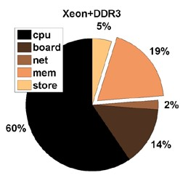
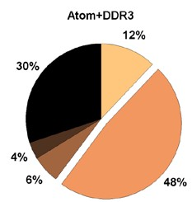
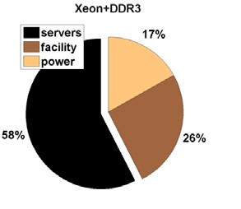
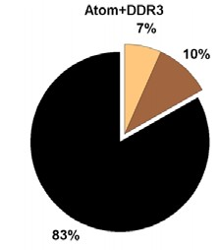
DRAM “Power Wall”
DRAM power is becoming harder to continue to scale down, resulting in cost burden in servers and in operation time restrictions in mobile systems
  DRAM supply voltage is expected to saturate at ~1.0V in the future
  Main memory power can take significant portion in servers (~50%)
  Power can occupy significant portion of server & infrastructure TCOs (~20%)
Xeon+DDR3 Atom+DDR3
5%
12%
19%
30%
DRAM Supply Voltage [V]
DDR1 2.5V
MEM
2%
60%
4%
MEM
DDR2 1.8V
14%
6%
48%
DDR3 1.5V
Power Breakdown across Server Components
DDR3U 1.25V
?
Xeon+DDR3 Atom+DDR3
17%
7%
10%
DDR3L 1.35V
Power
DDR4 1.2V
’00 ’02 ’04 ’06 ’08 ’10 ’12 ’14 ’16
58%
26%
’18 ‘20
83%
Total Cost of Ownership Breakdown
across Servers and Infrastructures
**Source: “Towards Energy-Proportional Datacenter Memory with Mobile DRAM,” ISCA 2012

Slide 17

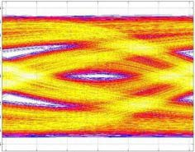
DRAM “Bandwidth Wall”
DDR4 is already starting to face frequency limitations and no DDR5 is on the horizon
  Multi-drop bus architecture inherently has many discontinuities resulting in I/O signal integrity degradation
  Gap between required system performance and achievable DRAM performance is growing
Multi-drop modules
Performance Requirement
System Requirement
CPU
I/O Speed Limit
Memory Subsystem

Slide 18
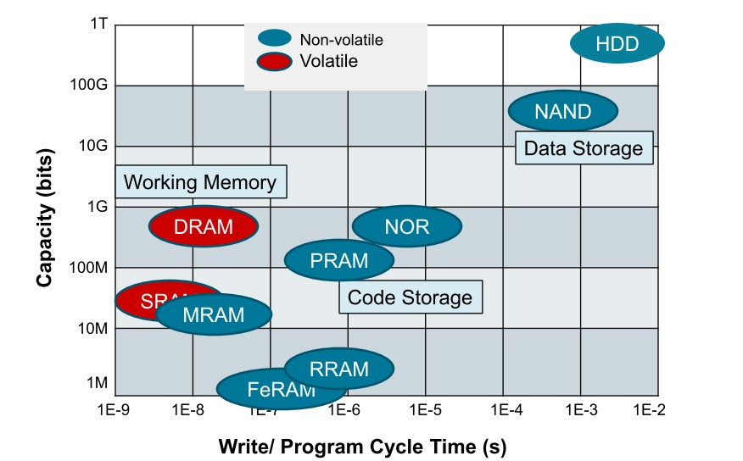












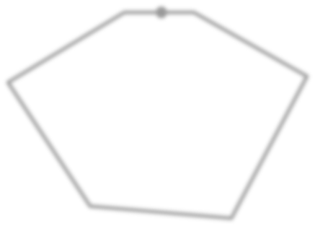
















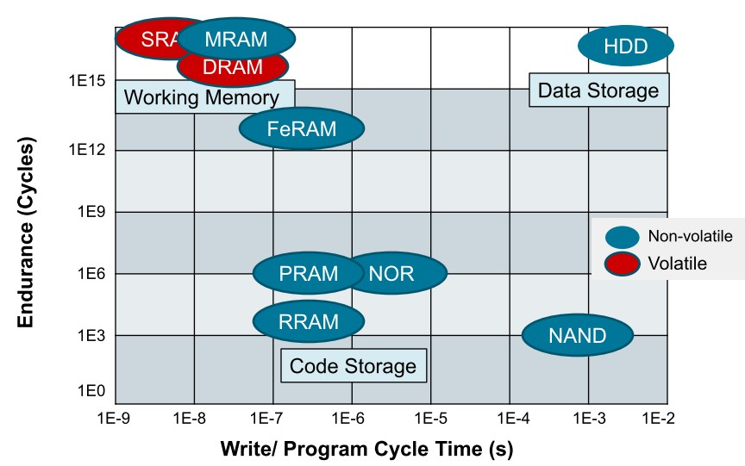


DRAM “Replacement Wall”
Many new memories are emerging, but none of them are comparable to DRAM in performance, endurance and technical maturity
STT-MRAM is the most promising candidate to replace DRAM but is still at its early development stage
Retention
Standby Power
DRAM
STT-MRAM
Speed (RD/WT)
Outer Better
Tech. Maturity
Bit cost
Endurance
(Scalability)
**Source: “Status and Prospect for MRAM Technology,”, HotChip 2010

Slide 19
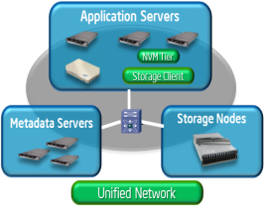
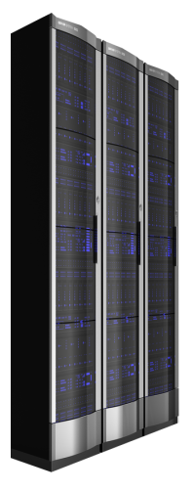
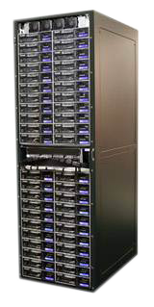
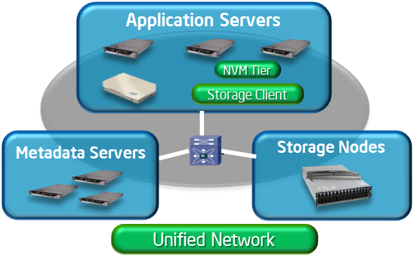

Addressing the Memory & Storage Opportunity:
Decentralizing Data
With Distributed Object Based Storage
Traditional
Distributed
Scalable
Fault Tolerant
Application Servers
SAN
(Storage Area Network)
19
Notes:
It’s not surprising that given all this growth in unstructured data that storage models must evolve to encompass more than centralized storage with limited scalability. To truly leverage the optimizations we’ve discussed -- as well as access massive data sets for analytics – new approaches are required. Storage is evolving to become a distributed workload or a service rather than separate centralized infrastructure. The distributed storage model is defined by distributed application servers, metadata servers, and archival nodes – all built on open industry standard servers and each running high performance processors. Application servers themselves are gaining storage intelligence and orchestrate hot data from local NVM tiers. Metadata servers are becoming the data directors -- providing intelligence to the distributed file system. And storage nodes will no longer be a bottleneck but far more intelligent and resilient.
As we move to this distributed model on a common network – storage is evolving to an network of storage networks –with appropriate tiering of storage throughout to meet different business service level needs. Intelligence will need to be embedded in every node throughout the infrastructure – to ensure optimization, to drive faster data access, and to orchestrate the network itself. With a highly distributed, tiered storage model, and intelligence at every node, IT teams will be able to unlock the insight that leads to true business value.

Slide 20
The I/O Opportunity:
Data Movement is Expensive
Compute vs. on-die interconnect energy (per mm)
Off-chip interconnect energy and data rate
& Memory
Source: Intel
Source: Intel
Interconnect energy (per mm) scales slower than compute
On-die data movement energy will start to dominate
Interconnect data rate increases slowly
Significant gap between research and production
20
Notes:
The graph to the left compares energy per operation of a compute operation over successive generation of technologies, and compares against energy of moving a bit over on-die interconnect by say one mm.
Notice that the interconnect energy reduces much slower than the compute energy. Therefore, interconnect related energy will start dominating in the future designs, necessitating restricting data movement.
Off-die interconnect energy and bandwidth is shown to the right. The energy is reducing, and the bandwidth is increasing, but probably not at the rate desired to support compute.
Also notice that there is a big gap between what is reported in the research papers in terms of energy efficiency and bandwidth, vs what is actually realized in production.
We need to pay attention to both on-die as well as off-die communication much more than in the past.

Slide 21




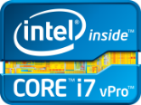
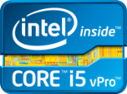


Smart City Big Data Architecture Framework
Intel® Many Integrated Core Architecture
Visualization & Interpretation
Based on Intel® microarchitecture-EX
Streaming
Analytics
[Un]Structured
Batch
Analytics
Data
Horizontal & Vertical Scale
Based on Intel microarchitecture-EP
Data Acquisition
Microserver
Based on Intel microarchitecture-EN
Local Analytics
Complex Event Processing
Analytics Processing
Preprocessing/
Cleansing/Filtering/
Aggregation
Horizontal Scale
Intel® Core™
Storage
Data Acquisition
Video Analytics
Sensors
Cameras
Core System-on-a-Chip
21

Slide 22
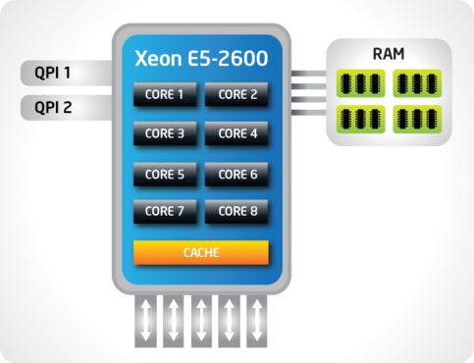
Choice of Compute Platforms Optimized for Big Data
Intel® Xeon® processor E5 Family
Intel Xeon processor E7 Family
RAM
QPI 1
Xeon E7-4800
QPI 2
CORE 1
CORE 2
QPI 3
CORE 3
CORE 4
QPI 4
CORE 5
CORE 6
Integrated
PCI Express* 3.0
Up to 40 lanes
per socket
Up to 4 channels
DDR3 1600 MHz
memory
CORE 7
CORE 8
Up to 8 channels
DDR3 1066 MHz
memory
CORE 9
CORE 10
Up to 8 cores
Up to 20 MB cache
4 QPI 1.0 Lanes for robust scalability
Up to 10 cores
Up to 30 MB cache
CACHE
Preferred solution for Hadoop* and scale-out analytic/DW engines
Up to 80% performance boost compared to prior generation
Intel® Integrated I/O with PCI Express* 3.0 provides more bandwidth for large data sets
Latest DDR3 memory technology/capacity for reduced memory latency
Preferred solution for in-memory analytic engines and enterprise databases
Highest cache and thread performance for large-dataset processing
Up to 2TB memory footprint (4-socket platform) for in-memory apps
Highest reliability and 8-socket+ scalability
Right Analytic Platforms begins with Intel Xeon processors
QPI = Intel® QuickPath Interconnect
Notes:
Key points:
Significant performance gains delivered by features such as new Intel® Advanced Vector Extensions and improved Intel® Turbo Boost Technology 2.0
To improve flexibility and operational efficiency significant improvements in I/O with new Intel® Integrated I/O which reduces latency ~30% will adding more lanes and higher bandwidth with support for PCI Express 3.0
Story:
To meet the growing demands of IT such as readiness for cloud computing, the growth in users and the ability to tackle the most complex technical problems, Intel has focused on increasing the capabilities of the processor that lies at the heart of a next generation data center.
The Intel Xeon processor E5-2600 product family is the next generation Xeon processor that replaces Platforms based on the Intel Xeon processor 5600 & 5500 series.
Continuing to build on the success of the Xeon 5600, the E5-2600 product family has increased core count and cache size in addition to supporting more efficient instructions with Intel® Advance Vector Extensions, to deliver up to an average of 80% more performance across a range of workloads.
These processors will offer better than ever performance no matter what your constraint is – floor space, power or budget – and on workloads that range from the most complicated scientific exploration to simple, yet crucial, web serving and infrastructure applications.
In addition to the raw performance gains, we’ve invested in improved I/O with Intel Integrated I/O which reduces latency ~30% will adding more lanes and higher bandwidth with support for PCIe 3.0. This helps to reduce network and storage bottlenecks to unleash the performance capabilities of the latest Xeon processor.
The Intel® Xeon® processor E5-2600 product family – versatile processers at the heart of today’s data center.
Let’s look at just what kind of performance that these products are capable of…
Legal Info:
Configuration for 80% claim:
Source: Performance comparison using best submitted/published 2-socket server results on the SPECfp*_rate_base2006 benchmark as of 6 March 2012. Baseline score of 271 published by Itautec on the Servidor Itautec MX203* and Servidor Itautec MX223* platforms based on the prior generation Intel® Xeon® processor X5690. New score of 492 submitted for publication by Dell on the PowerEdge T620 platform and Fujitsu on the PRIMERGY RX300 S7* platform based on the Intel® Xeon® processor E5-2690. For additional details, please visit www.spec.org. Intel does not control or audit the design or implementation of third party benchmark data or Web sites referenced in this document. Intel encourages all of its customers to visit the referenced Web sites or others where similar performance benchmark data are reported and confirm whether the referenced benchmark data are accurate and reflect performance of systems available for purchase.
Configuration for latency reduction: Source: Intel internal measurements of average time for an I/O device read to local system memory under idle conditions comparing the Intel® Xeon® processor E5-2600 product family (230 ns) vs.. the Intel® Xeon® processor 5500 series (340 ns). Baseline Configuration: Green City system with two Intel® Xeon® processor E5520 (2.26GHz, 4C), 12GB memory @ 1333, C-States Disabled, Turbo Disabled, SMT Disabled. New Configuration: Meridian system with two Intel® Xeon® processor E5-2665 (2.4GHz, 8C), 32GB memory @1600 MHz, C-States Enabled, Turbo Enabled. The measurements were taken with a LeCroy* PCIe* protocol analyzer using Intel internal Rubicon (PCIe* 2.0) and Florin (PCIe* 3.0) test cards running under Windows* 2008 R2 w/SP1.

Slide 23
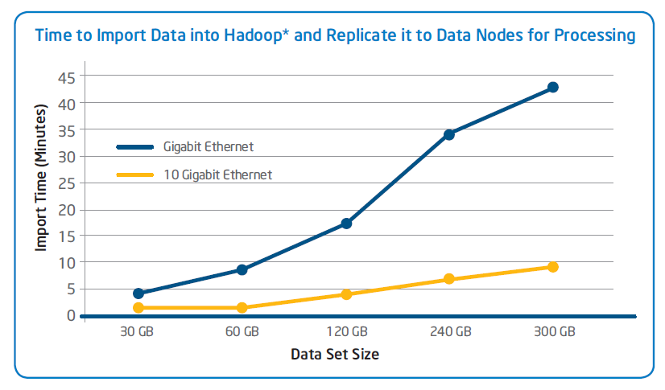
Platform and Software Optimizations for Hadoop*
Integrated
PCI Express* 3.0
Up to 40 lanes
per socket
Up to four channels
DDR3 1600 MHz
memory
Up to eight cores
Up to 20 MB cache
Up to 80% performance boost vs. prior generation
  Intel® Advanced Vector Extensions - reduce compute time
  Intel® Turbo Boost Technology - increased performance
Intel® Distribution for Apache Hadoop* software
  Built on open source releases
  Custom tuning for data types and scaling approaches
1 Performance comparison using best submitted/published 2-socket server results on the SPECfp*_rate_base2006 benchmark as of 6 March 2012.
2 Source: Intel internal measurements of average time for an I/O device read to local system memory under idle conditions comparing Intel® Xeon® processor E5-2600 product family (230 ns) vs.. Intel® Xeon® processor 5500 series (340 ns). See notes in backup for configuration details
* Other names and brands may be claimed as the property of others
QPI = Intel® QuickPath Interconnect
Intel® Xeon® processor E5
Notes:
Key points:
Starting with SNB generation, the Xeon CPU provides 2X better compression capability and 3X higher IO performance for storage at the same power envelope.
Integration of PCIe Gen3 enables higher IO Throughput, DDR3 integration enables lower latency and higher memory performance, integration of Integrated IO via PCH on MB enables higher IO processing native to CC, leading to better TDP for platforms over earlier platforms.
Sandy Bridge CPUs, developed on the 32 nm microarchitecture feature Intel’s latest innovation, Turbo Boost 2.0; Allowing the processors to enhance performance by boosting the processing beyond its base clock speed, thereby proving extremely useful during high work loads
Significant performance gains delivered by features such as new Intel® Advanced Vector Extensions and improved Intel® Turbo Boost Technology 2.0
To improve flexibility and operational efficiency significant improvements in I/O with new Intel® Integrated I/O which reduces latency ~30% will adding more lanes and higher bandwidth with support for PCI Express 3.0
Storage Application Architecture Balancing Capacity and Performance Reducing Triple Replication Processes For Object Code Data Type By 70%
Story:
Continuing to build on the success of the Xeon 5600, the E5-2600 product family has increased core count and cache size in addition to supporting more efficient instructions with Intel® Advance Vector Extensions, to deliver up to an average of 80% more performance across a range of workloads.
These processors will offer better than ever performance no matter what your constraint is – floor space, power or budget – and on workloads that range from the most complicated scientific exploration to simple, yet crucial, web serving and infrastructure applications.
In addition to the raw performance gains, we’ve invested in improved I/O with Intel Integrated I/O which reduces latency ~30% will adding more lanes and higher bandwidth with support for PCIe 3.0. This helps to reduce network and storage bottlenecks to unleash the performance capabilities of the latest Xeon processor.
The Intel® Xeon® processor E5-2600 product family – versatile processers at the heart of today’s data center.
Let’s look at just what kind of performance that these products are capable of…
Legal Info:
Configuration for 80% claim:
Source: Performance comparison using best submitted/published 2-socket server results on the SPECfp*_rate_base2006 benchmark as of 6 March 2012. Baseline score of 271 published by Itautec on the Servidor Itautec MX203* and Servidor Itautec MX223* platforms based on the prior generation Intel® Xeon® processor X5690. New score of 492 submitted for publication by Dell on the PowerEdge T620 platform and Fujitsu on the PRIMERGY RX300 S7* platform based on the Intel® Xeon® processor E5-2690. For additional details, please visit www.spec.org. Intel does not control or audit the design or implementation of third party benchmark data or Web sites referenced in this document. Intel encourages all of its customers to visit the referenced Web sites or others where similar performance benchmark data are reported and confirm whether the referenced benchmark data are accurate and reflect performance of systems available for purchase.
Configuration for latency reduction: Source: Intel internal measurements of average time for an I/O device read to local system memory under idle conditions comparing the Intel® Xeon® processor E5-2600 product family (230 ns) vs.. the Intel® Xeon® processor 5500 series (340 ns). Baseline Configuration: Green City system with two Intel® Xeon® processor E5520 (2.26GHz, 4C), 12GB memory @ 1333, C-States Disabled, Turbo Disabled, SMT Disabled. New Configuration: Meridian system with two Intel® Xeon® processor E5-2665 (2.4GHz, 8C), 32GB memory @1600 MHz, C-States Enabled, Turbo Enabled. The measurements were taken with a LeCroy* PCIe* protocol analyzer using Intel internal Rubicon (PCIe* 2.0) and Florin (PCIe* 3.0) test cards running under Windows* 2008 R2 w/SP1.

Slide 24
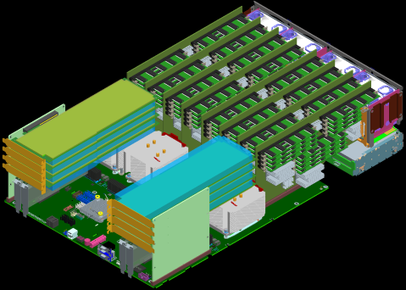
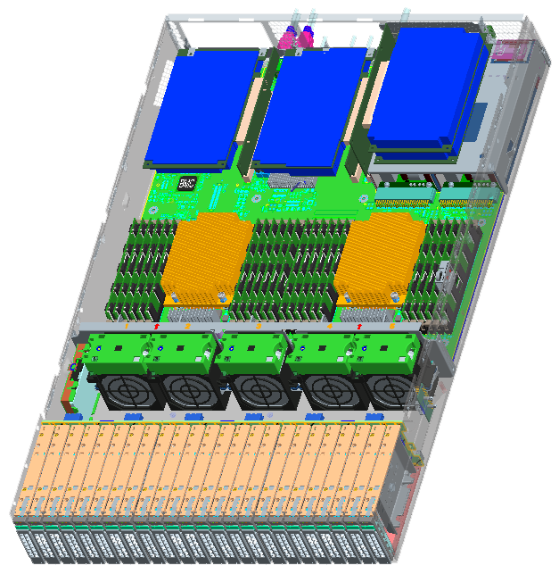
Low Density Servers
Intel® Xeon® processor 2S concept
Intel Xeon processor 4S concept
Delivering Performance/Power Efficiency

Slide 25
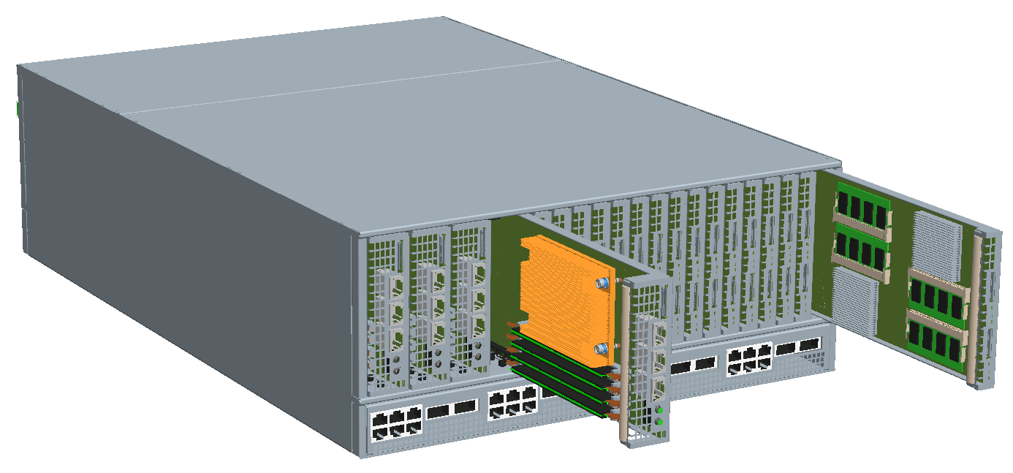
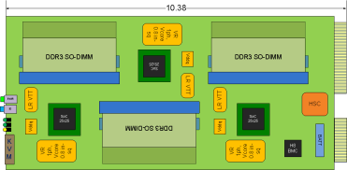
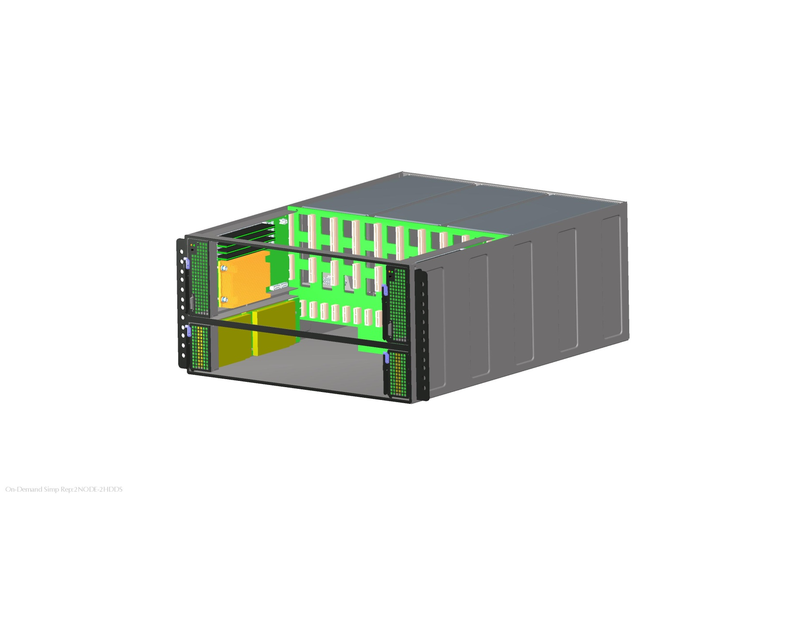
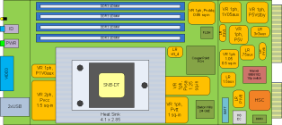
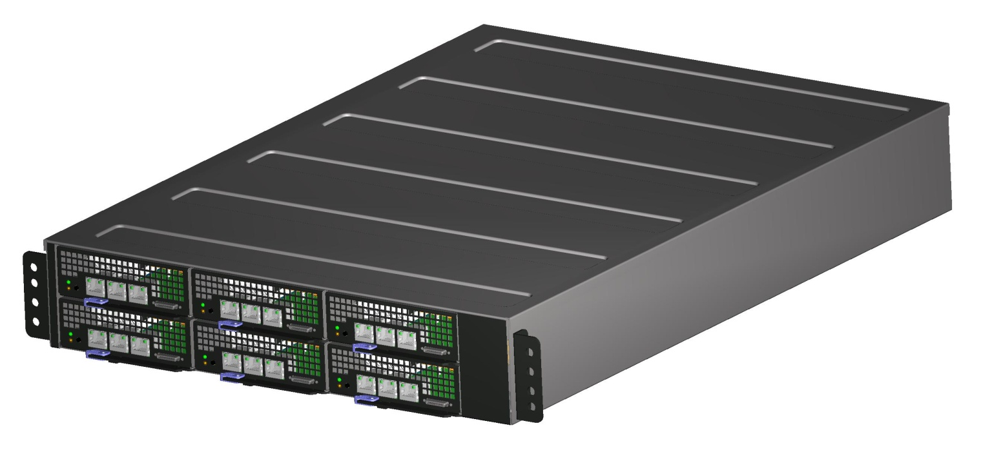
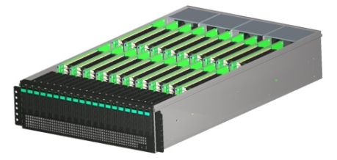
Microserver: High Density, Low Power System Innovations
Addressing the low power, high density packaging
Based on Intel® Atom™ processors
  Next generation Intel Atom processor codename Avoton
  Workloads
    Web tier, SaaS, IaaS, PaaS and light data analytics
  For scale-out apps

Slide 26




Transforming Storage
Data explosion …
Driving storage opportunity
690%
Growth in storage capacity 2010-2015⁺
Distributed
Storage
30% CAGR
Traditional
Storage
16% CAGR
Volume
Unstructured Data
Big Sensed Data
Intel® Xeon® processors provide storage intelligence
Big Corp Data
Big Web Data
Deduplication
Thin provisioning
Erasure code
MapReduce
Encryption
Structured Data
Corporate Data
Time
Source: Intel
Notes:
Key points: Big data is certainly the buzzword in the industry – but the phenomenon is real. And what we see is that it’s not traditional “structured” data that’s underlying the growth. Rather – “unstructured data” is both the challenge and opportunity. Unstructured data has little to no relational heirarchy and doesn’t fit well in traditional databases. Unstructured data includes everything from Facebook photo metadata (big web data) to the tracking of millions of RFID’s in retail (big sensed data).
But storing and managing all this data is a major challenge – which is why customers, particularly cloud customers, are turning to distributed storage vs more monolith designs.
The big driver for Intel in storage is “intelligence” and the move to distributed storage. The growth rates on distributed storage are impressive - far exeeding the demand for IT stalwarts like NAS and SAN. Cloud is leading this transition but increasingly in the enterprise. When doing analytics on very large sets of big data – it’s better to have more intelligence closer to more data – which is the Xeon opportunity . When you compare share of wallet –we see up to 3X better share in distributed model versus traditional fully integrated storage system.
NOTES on why SOW increases from traditional to distributed:
Traditional enterprise storage system is built on a custom proprietary architecture / distributed storage uses off the shelf 2U servers
Traditional system – heavy on proprietary software / distributed model uses open source (Hadoop or NoSQL type) software
Traditional system – lower end CPUs and less perf requirement per HDD / distributed has higher cores to HDD requirement = higher ASP silicon
690 percent growth in storage capacity based off Intel analysis and IDC data
between 2010 (26,066 petabytes) to 2015 (179,327) that is close to 690%

Slide 27
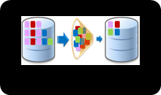
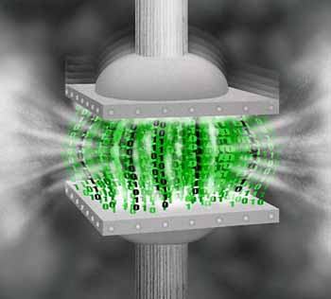
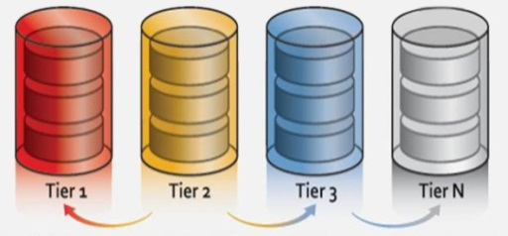
Intelligent Distributed Storage Optimizations
Intelligent pattern matching reduces large blocks of repeated data
BEFORE
AFTER
Real-Time Data Analytics
TRADITIONAL ALLOCATION
THIN PROVISIONING
On-demand utilization of available storage – virtual and real capacity
APPLI 2
ALLOCATED -FREE
SYSTEM-WIDE CAPACITY RESERVED
ALLOCATED - USED
APPLI 1
ALLOCATED -FREE
APPLI 2
ALLOCATED -USED
APPLI 1
Analysis of real-time storage determines extent and nature of compression
Strategic positioning of faster storage devices, improves storage performance
Notes:
Storyline: As we have highlighted, in order to keep data storage and management cost effective, there are many storage efficiency technologies being deployed including thin provisioning and data reduction technologies, such as data de-duplication and compression. These usage models are critical to enabling dynamic data centers and slowing the CAPEX growth by eliminating redundant data and making more efficient use of existing storage assets. Storage efficiency technologies reduce the amount of physical data on the disk drives required to store the logical copies of the data as seen by the file systems. Many of the technologies have become or are becoming mainstream capabilities. Key technologies include:
Data de-duplication: 95% smaller back up
Data de-duplication, initially introduced for backup systems, with many copies of the same or nearly the same data were being stored for recovery purposes.
This technology is now extending to inline production data, and is set to become a standard feature on storage controllers.
Data compression: 80% Data Reduction
Originally data compression was an offline process used to reduce the data held. Data compression, used in almost all tape systems, is now being extended to online production disk storage systems and is set to become a standard feature in many storage controllers.
The trend is toward real-time compression where performance is not compromised.
Intelligent tiering (often referred to as Automated tiering): 80% reduction in disk expenses
By moving “hot” data to faster storage devices (SSDs), tiered storage systems can perform faster without the expense of widely deploying these faster devices; improves storage performance by reducing the cost of capacity , moving “bulk” data to slower hence lower cost and larger-capacity drives.
This technology has the track record and the vendor breadth to become ubiquitous in 2012.
Thin provisioning: Upto 25% reduction in annual Storage CapEx
Thin provisioning gives the appearance of more physical capacity than is actually available, which enables administrators to automatically expand capacity on demand.
And that saves time and reduces the typical cost of having to overprovision available capacity well before you need it. This again has become a standard feature expected in storage arrays.
Transition: Thus far, we have talked about the Intelligent Storage features, lets view some of the benefits of implementing intelligent storage features within the core building block of the intelligent data center, the Converged Storage Server (CLICK)

Slide 28
Summary
“Big Data” Offers Big Opportunities to Industry, Academia,
and Consumers in General
New Technologies Have Shifted the Conversation From “What Data to Store” to “What Can We Do with More Data”
No Single Infrastructure Can Solve All Big Data Problems
“Big Data” Demands Innovations in Balanced System Architecture
Big Data = Big Security Challenge
28

Slide 29
Addressing The I/O Opportunity:
The Power of Integration
10-20
GB/sec
Processor
Fabric
Controller
32 GB/sec
System IO Interface (PCIe)
Fabric
Interface
Today
Processor
& Fabric Controller
10-20
GB/sec
Processor
Fabric
Controller
100+ GB/sec
32 GB/sec
Fabric Interface
System IO Interface (PCIe)
Fabric
Interface
Tomorrow
29

Slide 30
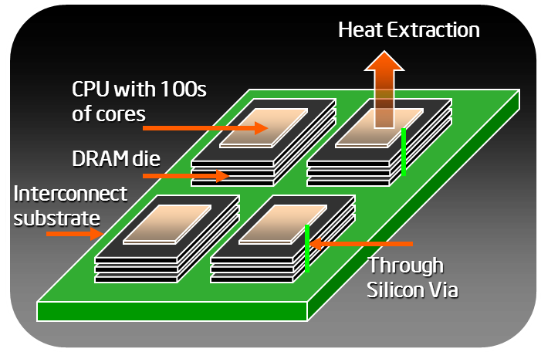
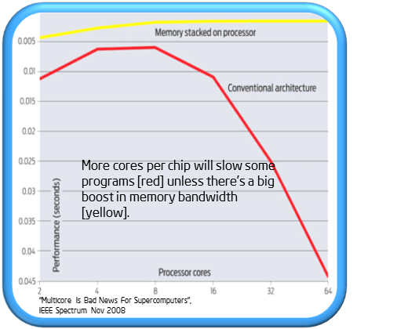

Addressing The I/O Opportunity:
3-D Integration of Dissimilar Technologies
30
Notes:
Intel worked with Micron in creating this prototype to demonstrate this new DRAM technology.
It demonstrates more than 10X bandwidth increase and almost 10X energy efficiency increase of memory access from 75 pJ/bit to 8 pJ/bit.

Slide 31










Stacking Technology
TSV (Through Silicon Via)
TSV can deliver less power consumption and higher speed by hiding electrical loading, simultaneously providing large capacity
TSV Conventional Stacking Power Comparison
Short Interconnection (<~50um)
Lower Profile
More # of Interconnects
(>1000ea)
Relative high cost
Long Loop Wires
Higher Profiles
Limitations in # of Interconnects
Overhang
Low Cost & Matured Technology
17% Saving
Features
Traditional RDIMM
TSV RDIMM
* Measured by 32GB RDIMM
@ 2DPC
High Performance, Low Power, and High Capacity

Slide 32

























Optical Interface
Mainly has been utilized in long distant communication Interface Power(I/O & Termination) getting dominant
Memory sub-system is relatively short channel environment
Potential to get ~60% better power efficiency over DDR3 interface
Opportunity to expand # of slots and support high pin speed
How to implement power efficient and low cost optical I/O solution?
I/F power getting dominant
Optical I/O : lower Power per B/W
40
)
s
p
b
G
/
W
m (
t
s
o C
r
e
w
o P
Power Cost[mW/Gbps]
30
DDR2 0.8Gbps
53%
DDR2 0.8Gbps
45%
36%
20
XDR 3.2Gbps
18%
21%
24%
60%
29%
34%
40%
DDR3 1.6Gbps
DDR3 1.6Gbps
GDDR5
GDDR5
Optical
40nm class 30nm class
I/O Power & Termination RCD Power
* Source : Samsung
20nm class
0
Optical
0
2
4 6 8
Bandwidth / pin[Gbps]
10
12
Core Power
Bandwidth / pin (Gbps)

Slide 33



















Controller Offloading
Potential advantages by additional functionalities in logic die
Distributed small scale computing
Reduced controller complexity & increased performance
Better system power efficiency with reduced data traffic
Additional logic to enhance device reliability and DRAM scaling extension
Supporting heterogeneous memories → DDR3, DDR4, PRAM, Flash, MRAM etc.
TSV
Memory Cube
Offloading Control & Computing
Technology agnostic High speed Memory Interface
Source: Hot chip 2011

Slide 34


Utilization of Non-Volatile Memory
Still premature technology
Directly replaceable to existing memory or complementary solution?
How can emerging memories be utilized in the system hierarchy to deliver best performance & power efficiency?

Slide 35

















Memory Hierarchy Differentiation
How to fit into the requirements of performance, capacity, power and etc.
Role assignment by purposes: Performance vs. Capacity
<eDRAM in 4th Gen. Intel Core CPU>
1.
High Perf.
Memory
 | SPEC
Capacity | 128MB
TDP | 4W
B/W | >50GB/s
CPU
2.
High Capacity Memory
<IDF2013>
Another level of cache or For Graphics?
High Performance Memory (HiPer)
  Bandwidth driven
  Latency advantage
High Capacity Memory (HiCap)
  Capacity driven
  Non-volatility
<High Performance Memory Options>

Slide 36
About the Course

Slide 37
2015 Comp620 Course Staff
Instructor:
  Wish I had TAs!
Office hours:
  TBD

Slide 38
Course Logistics
Course website:
TBD
  Lecture slides(To be posted to a Rice U website- TBD)
  Readings
Readings: Book Mining of Massive Datasets with A. Rajaraman and J. Ullman
Free online:
http://www.mmds.org

Slide 39
Work for the Course
(1+)4 longer homeworks: 40%
  Theoretical and programming questions
  HW0 (Hadoop tutorial) has just been posted
  Assignments take lots of time. Start early!!
How to submit?
  Homework write-up:
    Stanford students: In class or in Gates submission box
    SCPD students: Submit write-ups via SCPD
    Attach the HW cover sheet (and SCPD routing form)
  Upload code:
    Put the code for 1 question into 1 file and
    submit at: http://snap.stanford.edu/submit/

