Slide 1

Mining Data Streams
Note to other teachers and users of these slides: We would be delighted if you found this our material useful in giving your own lectures. Feel free to use these slides verbatim, or to modify them to fit your own needs. If you make use of a significant portion of these slides in your own lecture, please include this message, or a link to our web site: http://www.mmds.org
Mining of Massive Datasets
Jure Leskovec, Anand Rajaraman, Jeff Ullman Stanford University
http://www.mmds.org

Slide 2
Data Streams
In many data mining situations, we do not know the entire data set in advance
Stream Management is important when the input rate is controlled externally:
  Google queries
  Twitter or Facebook status updates
We can think of the data as infinite and
non-stationary (the distribution changes
over time)

Slide 3
The Stream Model
Input elements enter at a rapid rate,
at one or more input ports (i.e., streams)
  We call elements of the stream tuples
The system cannot store the entire stream accessibly
Q: How do you make critical calculations about the stream using a limited amount of memory?

Slide 4
Problems on Data Streams
Problems we are going to talk about today:
  Sampling data from a stream
    Construct a random sample
  Filtering a data stream: Bloom filters
    Select elements with property x from the stream
  Counting distinct elements: Flajolet-Martin
    Number of distinct elements in the last k elements
    of the stream

Slide 5
Sampling from a Data Stream:
Sampling a fixed proportion
As the stream grows the sample
also gets bigger

Slide 6
Sampling from a Data Stream
Since we can not store the entire stream,
one obvious approach is to store a sample
Two different problems:
  (1) Sample a fixed proportion of elements
  in the stream (say 1 in 10)
  (2) Maintain a random sample of fixed size
  over a potentially infinite stream
    At any “time” k we would like a random sample
    of s elements
      What is the property of the sample we want to maintain?
      For all time steps k, each of k elements seen so far has
      equal prob. of being sampled

Slide 7
Sampling a Fixed Proportion
Problem 1: Sampling fixed proportion
Scenario: Search engine query stream
  Stream of tuples: (user, query, time)
  Answer questions such as: How often did a user run the same query in a single day
  Have space to store 1/10th of query stream
Naïve solution:
  Generate a random integer in [0..9] for each query
  Store the query if the integer is 0, otherwise discard

Slide 8
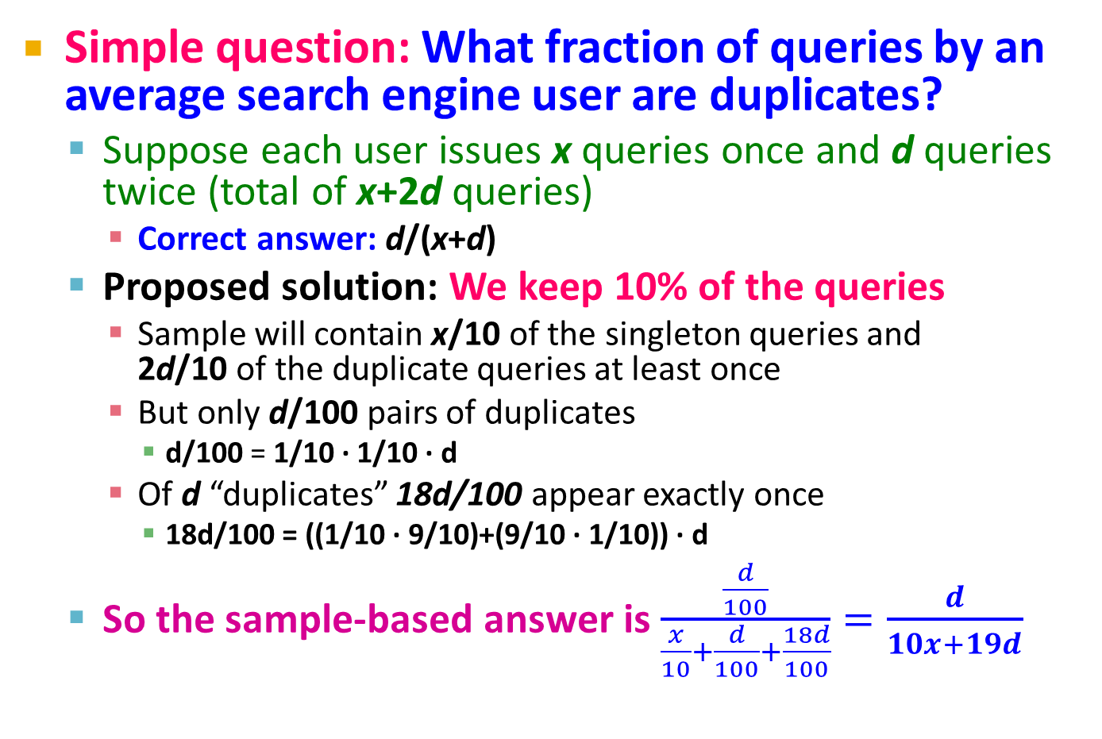
Problem with Naïve Approach
Simple question: What fraction of queries by an average search engine user are duplicates?
  Suppose each user issues x queries once and d queries twice (total of x+2d queries)
    Correct answer: d/(x+d)
  Proposed solution: We keep 10% of the queries
    Sample will contain x/10 of the singleton queries and
    2d/10 of the duplicate queries at least once
    But only d/100 pairs of duplicates
      d/100 = 1/10 ∙ 1/10 ∙ d
    Of d “duplicates” 18d/100 appear exactly once
      18d/100 = ((1/10 ∙ 9/10)+(9/10 ∙ 1/10)) ∙ d
  So the sample-based answer is $\frac{\frac{d}{100}}{\frac{x}{10}+\frac{d}{100}+\frac{18d}{100}}=\frac{d}{10x+19d}$
Notes:
d/100 appear twitece: 1st query gets sampled with prob. 1/10, 2nd also with 1/10, there are d such queries: d/100
18d/100 appear once. 1/10 for first to get selection and 9/10 for the second to not get selected. And the other way around so 18d/100

Slide 9
Solution: Sample Users
Solution:
Pick 1/10th of users and take all their
searches in the sample
Use a hash function that hashes the
user name or user id uniformly into 10 buckets

Slide 10
Generalized Solution
Stream of tuples with keys:
  Key is some subset of each tuple’s components
    e.g., tuple is (user, search, time); key is user
  Choice of key depends on application
To get a sample of a/b fraction of the stream:
  Hash each tuple’s key uniformly into b buckets
  Pick the tuple if its hash value is at most a
Hash table with b buckets, pick the tuple if its hash value is at most a.
How to generate a 30% sample?
Hash into b=10 buckets, take the tuple if it hashes to one of the first 3 buckets

Slide 11
Sampling from a Data Stream:
Sampling a fixed-size sample
As the stream grows, the sample is of fixed size

Slide 12
Maintaining a fixed-size sample
Problem 2: Fixed-size sample
Suppose we need to maintain a random
sample S of size exactly s tuples
  E.g., main memory size constraint
Why? Don’t know length of stream in advance
Suppose at time n we have seen n items
  Each item is in the sample S with equal prob. s/n
How to think about the problem: say s = 2
Stream: a x c y z k c d e g…
At n= 5, each of the first 5 tuples is included in the sample S with equal prob.
At n= 7, each of the first 7 tuples is included in the sample S with equal prob.
Impractical solution would be to store all the n tuples seen
so far and out of them pick s at random

Slide 13
Solution: Fixed Size Sample
Algorithm (a.k.a. Reservoir Sampling)
  Store all the first s elements of the stream to S
  Suppose we have seen n-1 elements, and now
  the n^{th} element arrives (n > s)
    With probability s/n, keep the n^{th} element, else discard it
    If we picked the n^{th} element, then it replaces one of the
    s elements in the sample S, picked uniformly at random
Claim: This algorithm maintains a sample S
with the desired property:
  After n elements, the sample contains each element seen so far with probability s/n

Slide 14
Proof: By Induction
We prove this by induction:
  Assume that after n elements, the sample contains each element seen so far with probability s/n
  We need to show that after seeing element n+1 the sample maintains the property
    Sample contains each element seen so far with probability s/(n+1)
Base case:
  After we see n=s elements the sample S has the desired property
    Each out of n=s elements is in the sample with probability s/s = 1

Slide 15
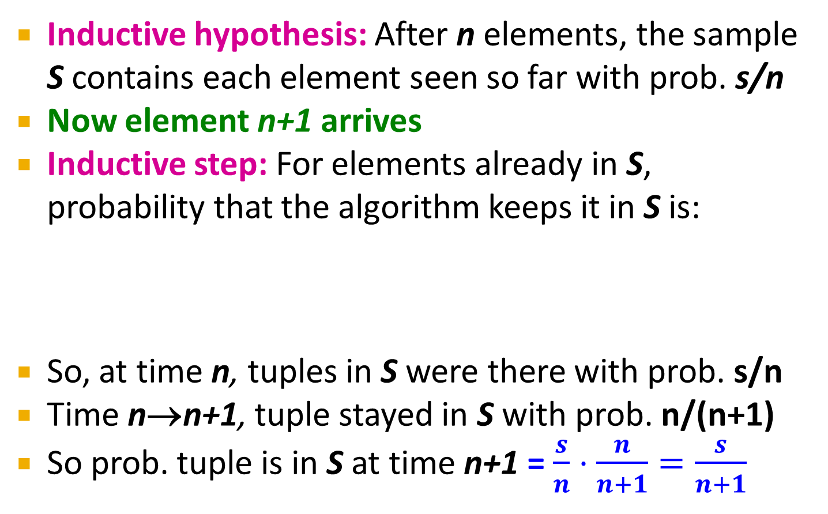
Proof: By Induction
Inductive hypothesis: After n elements, the sample S contains each element seen so far with prob. s/n
Now element n+1 arrives
Inductive step: For elements already in S, probability that the algorithm keeps it in S is:
So, at time n, tuples in S were there with prob. s/n
Time n→n+1, tuple stayed in S with prob. n/(n+1)
So prob. tuple is in S at time n+1 = $\frac{s}{n}⋅\frac{n}{n+1}=\frac{s}{n+1}$
Element n+1 discarded
Element n+1
not discarded
Element in the
sample not picked

Slide 16
Filtering Data Streams:
Bloom Filter

Slide 17
Filtering Data Streams
Each element of data stream is a tuple
Given a list of keys S
Determine which tuples of stream are in S

Slide 18
Applications
Example: Web crawler
  Given a webpage, find all links/URLs in the webpage that have not been visited
    Keep a list of all the URLs found so far
    Filter out URLs that has been seen before
    Crawl new URLs, and them add to the already-found list

Slide 19
First Cut Solution (1)
Given a set of keys S that we want to filter
Create a bit array B of n bits, initially all 0s
Choose a hash function h with range [0,n)
Hash each member of s∈ S to one of
n buckets, and set that bit to 1, i.e., B[h(s)]=1
Hash each element a of the stream and output only those that hash to bit that was set to 1
  Output a if B[h(a)] == 1

Slide 20
First Cut Solution (2)
Output the item since it may be in S.
Item hashes to a bucket that at least
one of the items in S hashed to.
Filter
Item
Hash
func h
0010001011000
Bit array B
Drop the item.
It hashes to a bucket set
to 0 so it is surely not in S.
Creates false positives but no false negatives
  If the item is in S we surely output it, if not we may still output it

Slide 21
First Cut Solution (3)
|S| = 1 billion keys
|B|= 1GB = 8 billion bits
If the stream element is in S, then it surely hashes to a bucket that has the bit set to 1,
so it always gets through (no false negatives)
Approximately 1/8 of the bits are set to 1, so about 1/8 of the elements not in S get through to the output (false positives)
  But more than one keys may hash to the same bit

Slide 22
Analysis: Throwing Darts (1)
More accurate analysis for the number of false positives
Consider: If we throw m darts into n equally likely targets, what is the probability that
a target gets at least one dart?
In our case:
  Targets = bits/buckets
  Darts = hash values of items

Slide 23
Analysis: Throwing Darts (2)
We have m darts, n targets
What is the probability that a target gets at least one dart?
Equals 1/e
as n →∞
Equivalent
n(
m
/ n)
1 -
(1 – 1/n)
1 – e^{–m/n}
Probability some
target X not hit
by a dart
Probability at
least one dart
hits target X

Slide 24
Analysis: Throwing Darts (3)
Fraction of 1s in the array B =
= probability of false positive = 1 – e^{-m/n}
Example: 10⁹ darts, 8∙10⁹ targets
  Fraction of 1s in B = 1 – e^{-1/8} = 0.1175
    Compare with our earlier estimate: 1/8 = 0.125

Slide 25
Bloom Filter
Consider: |S| = m, |B| = n
Use k independent hash functions h₁ ,…, h_{k}
Initialization:
  Set B to all 0s
  Hash each element s∈ S using each hash function h_{i}, set B[h_{i}(s)] = 1 (for each i = 1,.., k)
Run-time:
  When a stream element with key x arrives
    If B[h_{i}(x)] = 1 for all i = 1,..., k then declare that x is in S
      That is, x hashes to a bucket set to 1 for every hash function h_{i}(x)
    Otherwise discard the element x
(note: we have a
single array B!)

Slide 26
Bloom Filter -- Analysis
What fraction of the bit vector B are 1s?
  Throwing k∙m darts at n targets
  So fraction of 1s is (1 – e^{-km/n})
But we have k independent hash functions
and we only let the element x through if all k hash element x to a bucket of value 1
So, false positive probability = (1 – e^{-km/n})^{k}

Slide 27
Bloom Filter – Analysis (2)
m = 1 billion, n = 8 billion
  k = 1: (1 – e^{-1/8}) = 0.1175
  k = 2: (1 – e^{-1/4})² = 0.0493
What happens as we
keep increasing k?
“Optimal” value of k: n/m ln(2)
  In our case: Optimal k = 8 ln(2) = 5.54 ≈ 6
    Error at k = 6: (1 – e^{-1/6})² = 0.0235
False positive prob.
Number of hash functions, k

Slide 28
Bloom Filter: Wrap-up
Bloom filters guarantee no false negatives, and use limited memory
  Great for pre-processing before more
  expensive checks
Suitable for hardware implementation
  Hash function computations can be parallelized
Is it better to have 1 big B or k small Bs?
  It is the same: (1 – e^{-km/n})^{k} vs. (1 – e^{-m/(n/k)})^{k}
  But keeping 1 big B is simpler

Slide 29
Counting Distinct Elements

Slide 30
Counting Distinct Elements
Problem:
  Data stream consists of a universe of elements chosen from a set of size N
  Maintain a count of the number of distinct elements seen so far
Obvious approach:
Maintain the set of elements seen so far
  That is, keep a hash table of all the distinct elements seen so far

Slide 31
Applications
How many different Web pages does each customer request in a week?
How many distinct products have we sold in the last week?

Slide 32
Using Small Storage
Real problem: What if we do not have space
to maintain the set of elements seen so far?
Estimate the count in an unbiased way
Accept that the count may have a little error, but limit the probability that the error is large

Slide 33
Flajolet-Martin Approach
Pick a hash function h that maps each of the N elements to at least log₂ N bits
For each stream element a, let r(a) be the number of trailing 0s in h(a)
  r(a) = position of first 1 counting from the right
    E.g., say h(a) = 12, then 12 is 1100 in binary, so r(a) = 2
Record R = the maximum r(a) seen
  R = max_{a} r(a), over all the items a seen so far
Estimated number of distinct elements = 2^{R}

Slide 34
Why It Works: Intuition
Very very rough and heuristic intuition why
Flajolet-Martin works:
  h(a) hashes a with equal prob. to any of N values
  Then h(a) is a sequence of log₂ N bits,
  where 2^{-r} fraction of all as have a tail of r zeros
    About 50% of as hash to ***0
    About 25% of as hash to **00
    So, if we saw the longest tail of r=2 (i.e., item hash
    ending *100) then we have probably seen
    about 4 distinct items so far
  So, it takes to hash about 2^{r} items before we
  see one with zero-suffix of length r

Slide 35
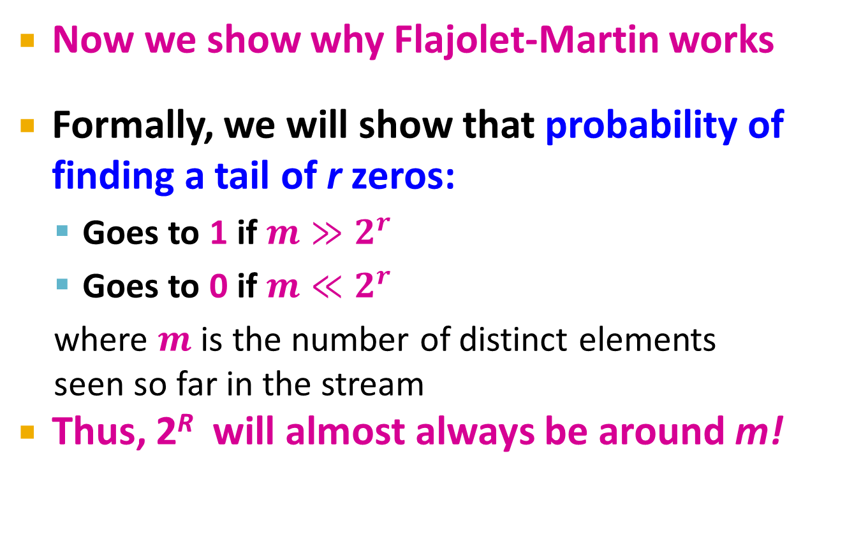
Why It Works: More formally
Now we show why Flajolet-Martin works
Formally, we will show that probability of finding a tail of r zeros:
  Goes to 1 if $m≫2^{r}$
  Goes to 0 if $m≪2^{r}$
  where $m$ is the number of distinct elements
  seen so far in the stream
Thus, 2^{R} will almost always be around m!

Slide 36
Why It Works: More formally
What is the probability that a given h(a) ends
in at least r zeros is 2^{-r}
  h(a) hashes elements uniformly at random
  Probability that a random number ends in
  at least r zeros is 2^{-r}
Then, the probability of NOT seeing a tail
of length r among m elements:
$${\left(1−2^{−r}\right)}^{m}$$
Prob. all end in
fewer than r zeros.
Prob. that given h(a) ends in fewer than r zeros

Slide 37
Why It Works: More formally
Note:
Prob. of NOT finding a tail of length r is:
  If m << 2^{r}, then prob. tends to 1
    as m/2^{r}→ 0
    So, the probability of finding a tail of length r tends to 0
  If m >> 2^{r}, then prob. tends to 0
    as m/2^{r} → ∞
    So, the probability of finding a tail of length r tends to 1
Thus, 2^{R} will almost always be around m!

Slide 38
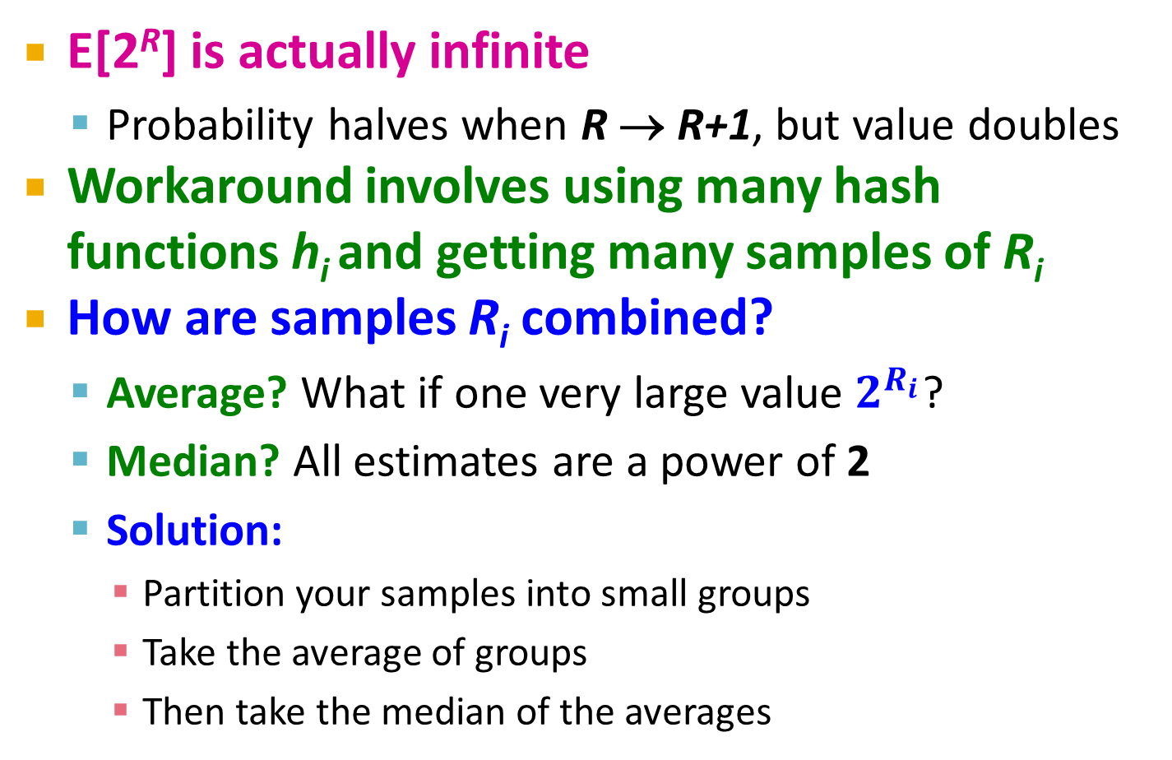
Why It Doesn’t Work
E[2^{R}] is actually infinite
  Probability halves when R → R+1, but value doubles
Workaround involves using many hash functions h_{i} and getting many samples of R_{i}
How are samples R_{i} combined?
  Average? What if one very large value $2^{R_{i}}$?
  Median? All estimates are a power of 2
  Solution:
    Partition your samples into small groups
    Take the average of groups
    Then take the median of the averages

