Slide 1
Design Patterns for Sorting something old in a new light
Dung “Zung” Nguyen, Rice University
Stephen Wong, Rice University

Slide 2
What is Sorting Anyway?
Some concrete examples:
Selection sort
Insertion sort
Can We Abstract All Sorting Processes?
Notes:
More than just a bunch of different loops
How can we express what is going on in a cohesive way?

Slide 3
Merritt’s Thesis for Sorting
All comparison-based sorting can be viewed as “Divide and Conquer” algorithms.
Sort a pile
  Split the pile into smaller piles
  Sort each the smaller piles
  Join the sorted smaller piles into sorted pile

Slide 4
Hypothetical
Sort
Unsorted
split
split
split
split
Divide and Conquer!
How can we capture this abstraction?
split
join
join
join
join
join
Sorted
= unsorted
= sorted
= sort process

Slide 5
Abstract Sorter Class
if (lo < hi) {
int s = split (A, lo, hi);
sort (A, lo, s-1);
sort (A, s, hi);
join (A, lo, s, hi);
}
Concrete
“Template Method”
ASorter
+ void: sort(Object[ ] A, int: lo, int: hi);
abstract,
relegated to subclasses
# int: split(Object[] A, int lo, int hi);
# void: join(Object[] A, int lo, int s, int hi);
Selection
Insertion
SortAlgo
Notes:
Explain UML diagram -- industry standard.

Slide 6
Template Method Pattern
invariant () {
…
variant1 (…);
…
variant2 (…);
…
}
AClass
+ invariant(…);
# variant1(…);
# variant2(…);
Expresses invariant in terms of variants.
White-box Framework:
  Extension by subclassing
ConcreteX
ConcreteY
# variant1(…);
# variant1(…);
# variant2(…);
# variant2(…);
Notes:
The variant behavior is a service to the framework.

Slide 7
Sort Framework
void sort (Object A[ ], int lo, int hi) {
if (lo < hi) {
int s = split (A, lo, hi);
sort (A, lo, s-1);
sort (A, s, hi);
join (A, lo, s, hi);
}
}
Recursive case
// A[lo:s-1], A[s:hi] form a proper partition of A[lo:hi].
// A[lo:s-1] is sorted.
“Free”
// A[s:hi] is sorted.
Focus points
// A[lo:hi] is sorted.
// else if (hi <= lo) do nothing!
Base case is trivial
Notes:
What does the framework buy us?
Reduced code complexity and as a result simplicity!
Need only focus on making sure that split and join establish their respective post-conditions.
Proper partitions = both non-empty

Slide 8
Insertion Sort
Reduces to insertion of a single object into a sorted array.
Simplifies proof of correctness.
int split(Object[] A, int lo, int hi) {
  return hi;
  // A splits into A[lo:hi-1] and A[hi:hi]
  }
void join(Object[] A, int lo, int s, int hi) {
  // Pre: A[lo:hi-1] is sorted, s = hi.
  Object key = A[hi];
  int j;
  for (j = hi; lo < j && aOrder.lt(key, A[j-1]); j- -)
  A[j] = A[j-1];
  A[j] = key;
  // Post: A[hi] is inserted in order into A[lo:hi-1]
  }
Notes:
lo < hi strictly
s<= hi
Framework enforces correctness.
aOrder is an ordering strategy to be discussed by Stephen later.
Students are able to experience a framework system on a small but practical scale.

Slide 9
Selection Sort
Reduces to selecting a minimum value in the array.
Simplifies proof of correctness
int split(Object[] A, int lo, int hi) {
  int s = lo;
  for (int i= lo+1; i <= hi; I++) {
  if (aOrder.lt(A[i], A[s])) s = i;
  }
  // s = index of min value
  swap (A, lo, s);
  // A[lo] = min value in A[lo:hi]
  return lo + 1;
  // A splits into A[lo:lo] and A[lo+1:hi]
  }
void join(Object[] A, int lo, int s, int hi) { }
Do Nothing!

Slide 10
Time Complexity
void sort (Object A[ ], int l, int h) {
  if (l < h) {
    int s = split (A, l, h);
    sort (A, l, s-1);
    sort (A, s, h);
    join (A, l, s, h);}}
T(l, h)
  C
    S(l, h)
    T(l, s-1)
    T(s, h)
    J(l, s, h)
T(l, h) =
  C if h <= l
  C + S(l, h) + T(l, s-1) + T(s, h) + J(l, s, h) if l < h
Notes:
Recurance relation

Slide 11
Insertion Sort Complexity
int split (Object[ ] A, int l, int h) {
return h;
} // O(1)
void join (Object[ ] A, int l, int s, int h) {
Object key = A[h]; int j;
for (j = h; l < j && aOrder.lt(key, A[j-1]); j- -)
A[j] = A[j-1]; A[j] = key;
} // O(h-l)
s = h
O(n), n = h - l
T(l, h) =
  C if h <= l
  C + S(l, h) + T(l, h-1) + T(h, h) + J(l, h, h) if l < h
T(l, h) =
  C if h <= l
  C + S(l, h) + T(l, s-1) + T(s, h) + J(l, s, h) if l < h
O(1)
Let n = h – l, T(l, h) = T(n) =
  C if n < 1
  T(n-1) + O(n) = O(n²) if 1 <= n

Slide 12
Sorting as a Framework
if (lo < hi) {
int s = split (A, lo, hi);
sort (A, lo, s-1);
sort (A, s, hi);
join (A, lo, s, hi);}
ASorter
+ void: sort(Object[ ] A, int: lo, int: hi);
# int: split(Object[] A, int lo, int hi);
# void: join(Object[] A, int lo, int s, int hi);
Unifies sorting under one foundational principle:
Divide and Conquer!
Reduces code complexity. Increases robustness.
Simplifies program verification and complexity analysis.

Slide 13
Classifications
Easy split/Hard join
Insertion
Merge
ASorter
+ void: sort(Object[] a, int: lo, int: hi);
# int: split(Object[] A, int lo, int hi);
# void: join(Object[] A, int lo, int s, int hi);
Selection
QuickSort
HeapSort
Bubble
Hard split/Easy join

Slide 14
Not Just Buzzwords…
It’s more than just sorting…
It’s all about abstraction…
Abstraction teaches software engineering
Reusability: write once/use many
  Reuse the invariant: the framework
Flexibility: change the variants
  Add new sorters
  Change sort order
Extensibility: add new capabilities
  Visualization
  Performance measurements

Slide 15
Extending Without Changing
The Abstract is the Invariant
  Graphics, sort order and performance measurements are completely separate from the sorting.
  Add functionality to the sorters, ordering operators, and sortable objects without disturbing their abstract behavior.
  Wrap the sorters, operators and objects in something abstractly equivalent that adds functionality: Decorators
Notes:
Run demo again
Emphasize on separation of sorting and animation.
Visualization helps student understand the “picture” of sorting, but what we want to teach here is software engineering as well.

Slide 16
Decorator Design Pattern
Subclass holds an instance of its superclass
Decorator intercepts
calls to decoree
Client
uses
AComponent
+ Object: method(Object x)
1
Client deals with
an abstract entity
// do additional processing
Object y = decoree.method(x);
// do more processing
return y;
Decorator
ConcreteImpl
- AComponent: decoree
+ Object: method(Object x)
+ Object: method(Object x)
Decorator is abstractly equivalent to the decoree
Decorators can be layered on top of each other
Client doesn’t know the decoration exists!
Decorator performs additional processing

Slide 17
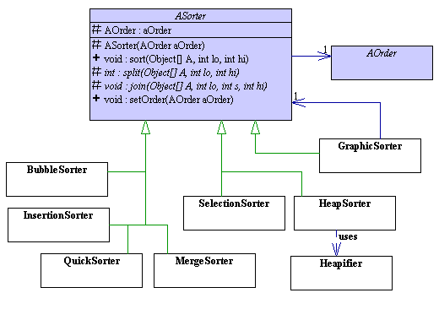
Sorters
Abstract
Template
Pattern
sorter
Concrete
sorters implement
split() & join()
ASorter uses the ordering strategy for comparisons
“Decoratable”!
Abstract objects
being sorted
Sort using an
abstract ordering
strategy
“Decoratable”!
Decorated
ASorter
for graphical
split & join
Notes:
Discuss strategy pattern also.
Decorate sorter and strategy because we have the abstract class

Slide 18
GraphicSorter Decorator
Decoree.
private ASorter sorter;
int split(Object[] A, int lo, int hi) {
int s = sorter.split(A, lo, hi);
// recolor split sections and pause
return s;
}
void join(Object[] A, int lo, int s, int hi) {
sorter.join(A, lo, s, hi);
// recolor joined sections and pause
}
Delegation to
the decoree.
Graphics
decoration.
Identical behavior
as the decoree.
Delegation to
the decoree.
Graphics
decoration.

Slide 19
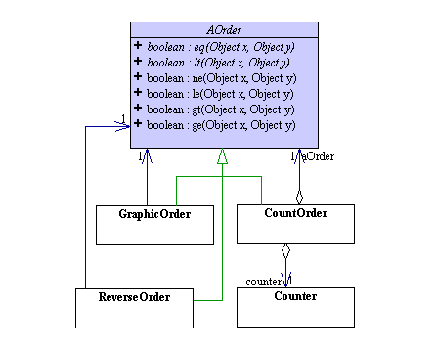
Comparison Strategies
Abstract
comparison
operator
Decorated
AOrder
to graphically
show
comparisons
Decorated
AOrder
to count
comparisons
Decorated
AOrder
to reverse
sort order
Notes:
STRATEGY PATTERN
Show demo program to point out:
Graphical comparison
Performance measurements
Reverse sort order

Slide 20
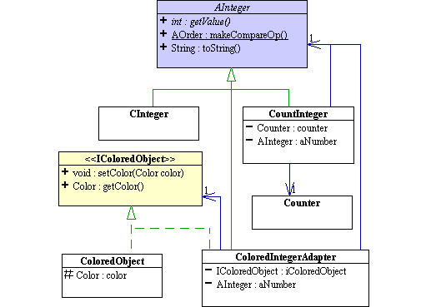
Sortable Integers
Abstract
class
Concrete
implementation
Factory
method
for
comparison
strategy
Decorated
AInteger
to count
accesses
IColoredObject adapter
+ AInteger decorator
for graphics

Slide 21
Beyond sorting…
Design Patterns Express Abstraction
Instead of disparate and complex
Abstraction unifies and simplifies
Abstraction enables flexibility and extensibility
Instead of rigidity and limitedness
Change the way
we think!
Notes:
Instead of an amalgam of disparate and complex concrete algorithms, abstraction creates a unified and simplified whole.
Instead of a rigid and limited set of tools, abstraction enables as a flexible and extensible system of cooperating components.

Slide 22
Download the paper! http://exciton.cs.rice.edu/research/SIGCSE01

