Slide 1

Intro to GarageBand
Digital Media Commons
Fondren Library B42
dmc.rice.edu
dmc-info@rice.edu | (713) 348-3635

Slide 2
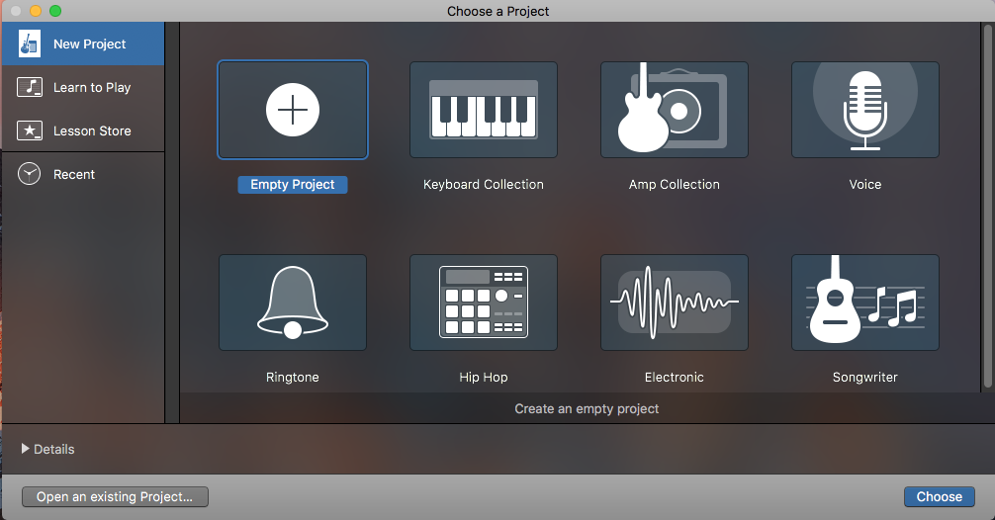
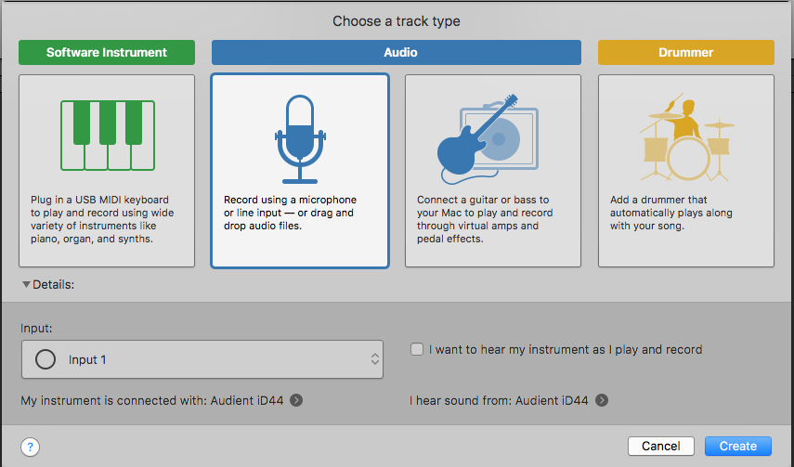
Choose “Empty Project”
Choose the microphone option
Set input accordingly
Check “I want to hear…” if you are not using an audio interface

Slide 3
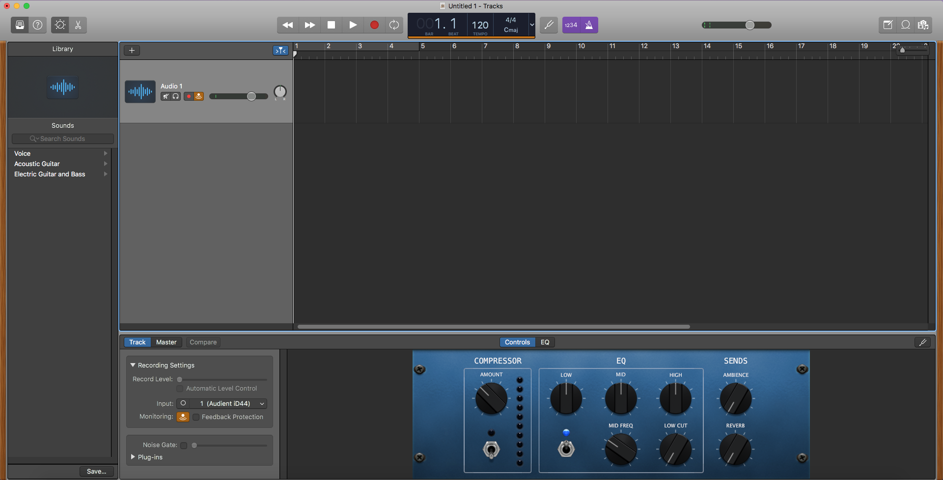
Playback/Record
Controls
Click to toggle metronome
Smart Controls
Editor
Track List
Timeline
Track
Recording Settings
Use to add reverb to your voice

Slide 4
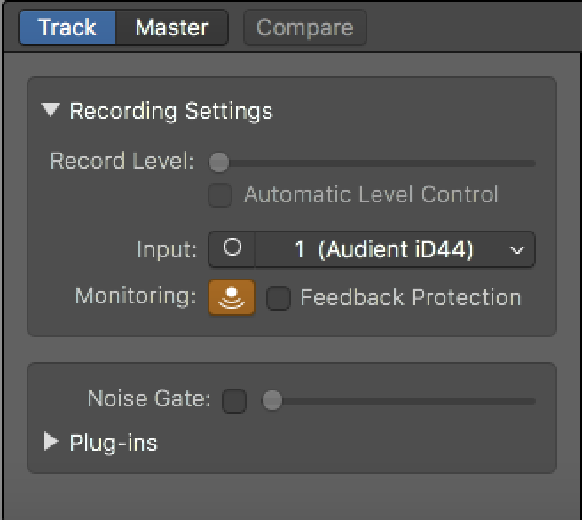
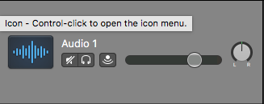
Record Level changes your mic’s input volume
Changes Track’s volume
Pans Track to left or right
Mutes Track
“Solos” Track

Slide 5
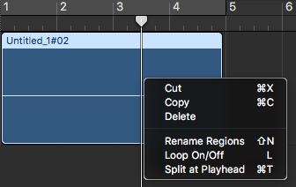
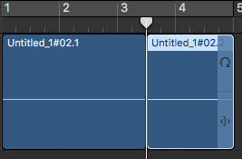
Right-click a recording to bring up options
Click “Split at Playhead” (or Command-T)
Click and drag to loop segment
Click and drag to shorten or lengthen segment

Slide 6
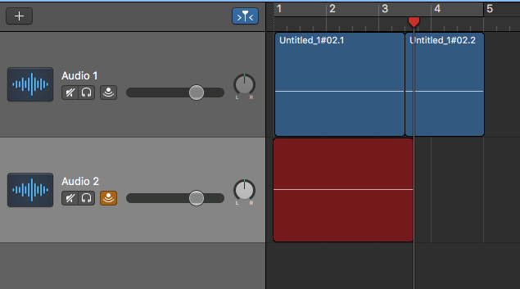
Click to add track
When recording a new track, you can hear the other tracks unless you mute them

Slide 7
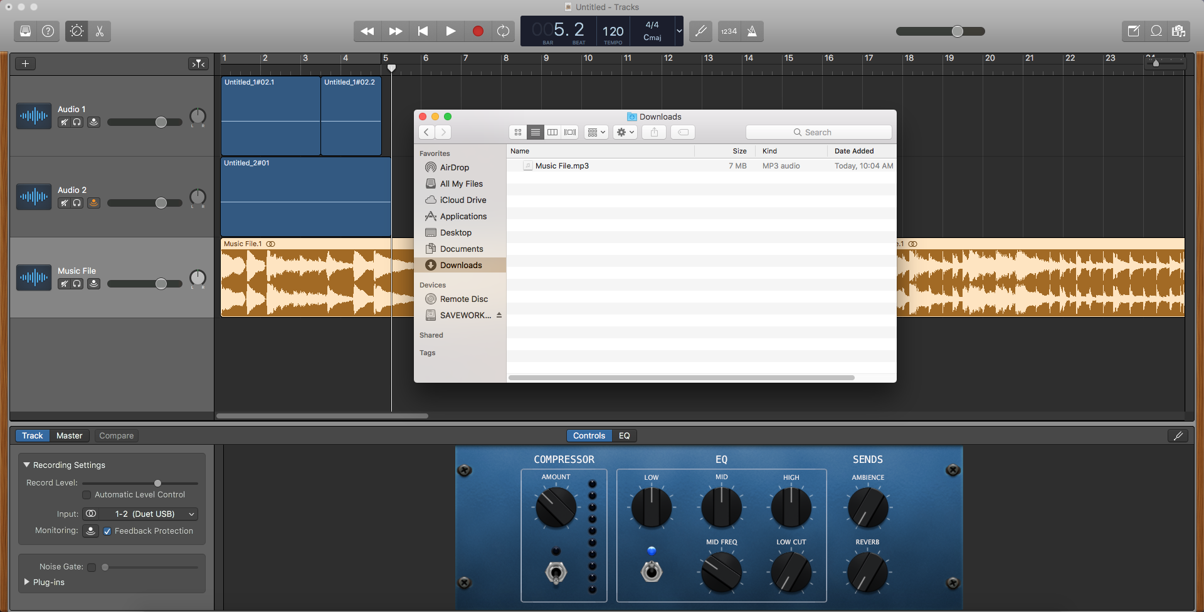
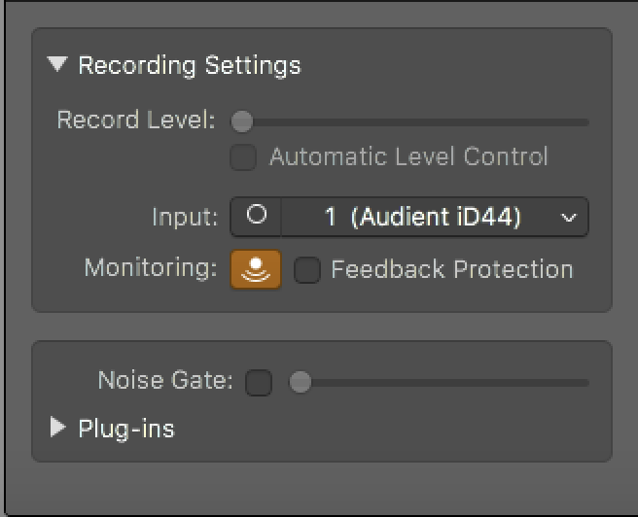
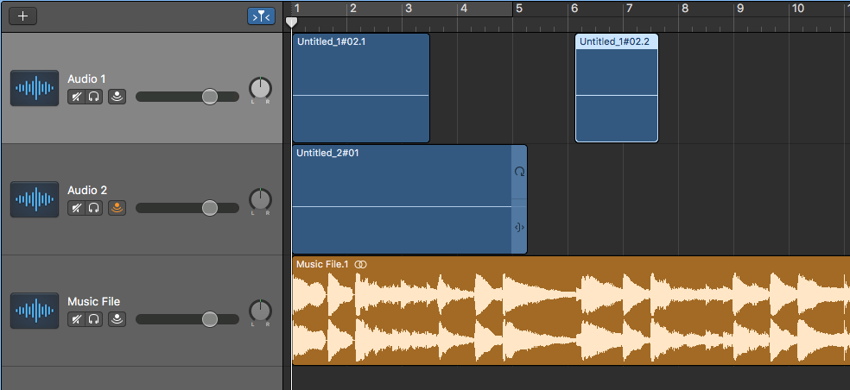
Drag a music file onto the empty space in the track list to add a music track.
You can do this with multiple audio files and rearrange them along the timeline.
Click and drag a clip to move it along the timeline

Slide 8
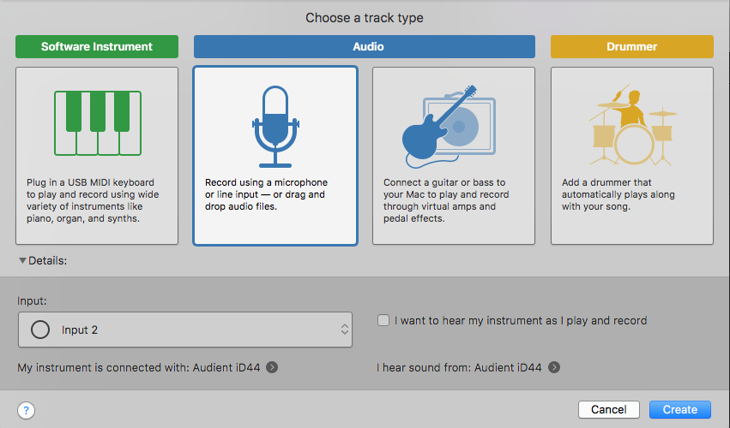
Recording to Multiple Tracks Simultaneously
Add one track using input 1 and a second track using input 2. Keep in mind that the Audient iD44 USB interface allows for 4 true inputs.

Slide 9
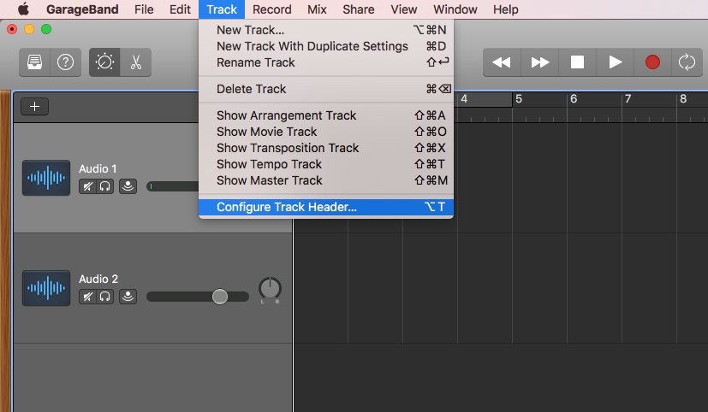
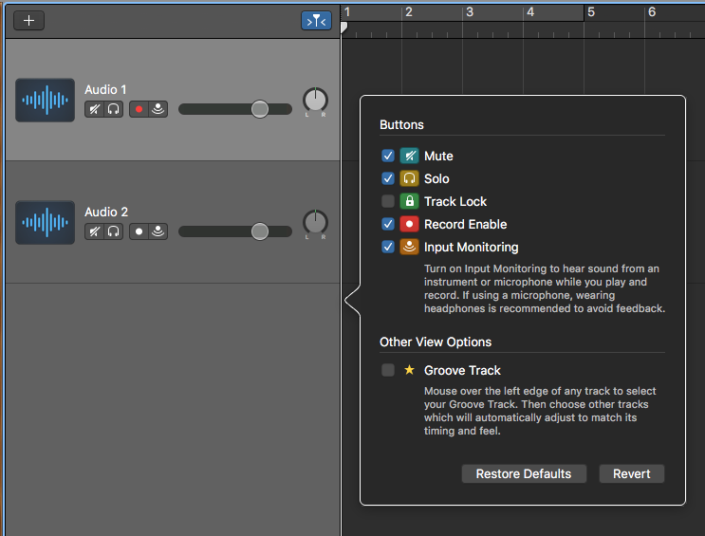
At the top: click “Track”, then click “Configure Track Header…”
In the prompt that shows up, check the box next to “Record Enable”

Slide 10
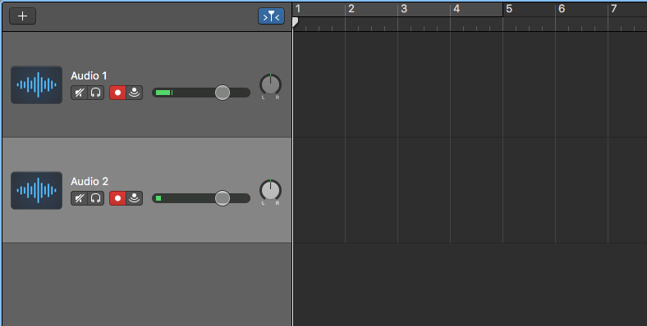
Click the new Record Enable button on each track.
Once they are primed for recording, the buttons will flash red.
Once you start recording, they will turn solid red.

Slide 11
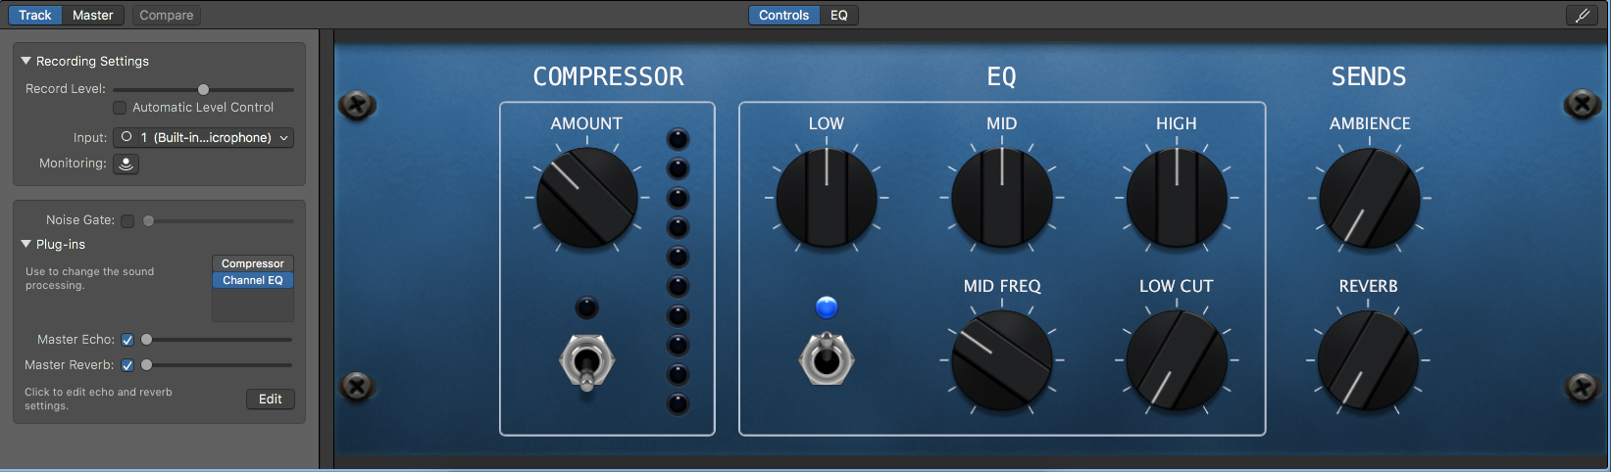
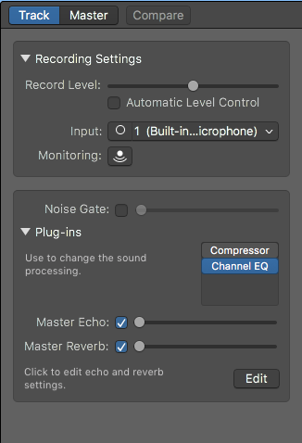
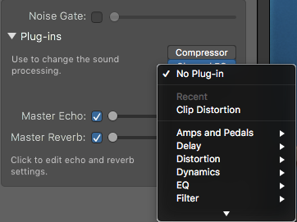
Smart Controls
Open the smart controls panel by either using the dial icon at the top or by double clicking the track you want to edit.
By default, every recording track has compressor and Channel EQ.
The Plug-Ins panel is where you can add or toggle plug-ins.

Slide 12
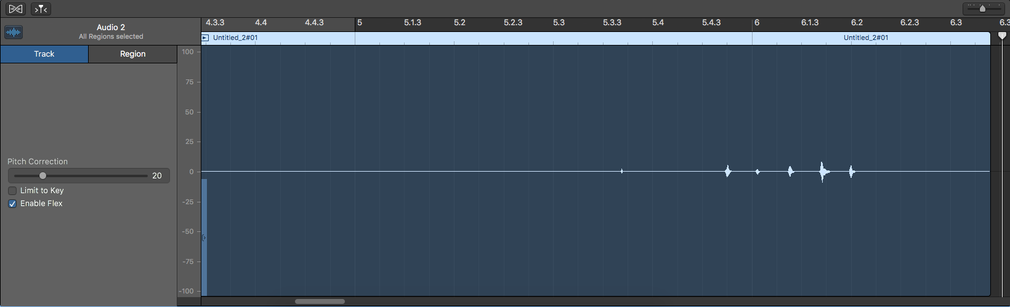
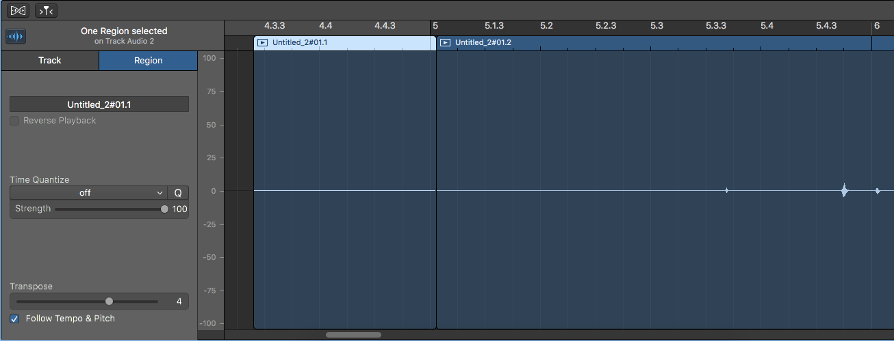
Pitch Correction
Open the editor by either using the scissors at the top or by double clicking the audio you want to edit.
You can split tracks but double-clicking in the bottom half of the track (below the waveform).
Use the pitch correction slider to add correction for the *entire track*.
Too much pitch correction will result in robotic sounds.
Change to the Region tab to transpose sections manually.

Slide 13

Using GarageBand’s
Loop Library
At the top right, you’ll find three icons.
The center icon will open the loop library.

Slide 14
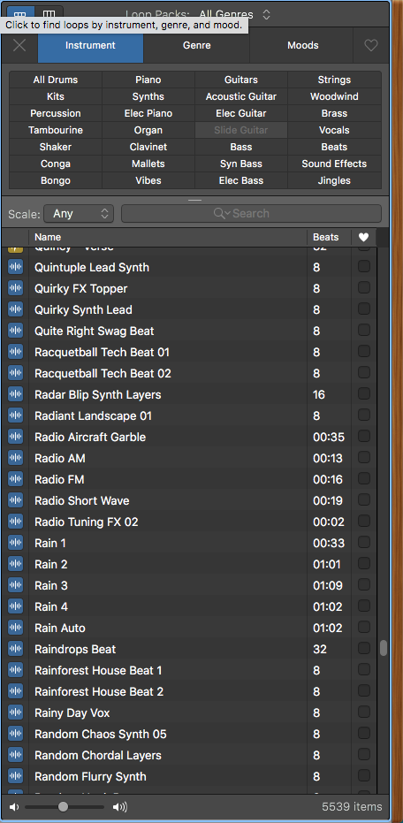
You can browse for loops and sounds using the three tabs at the top:
instrument, genre, and moods.
The beats column will tell you if the sound is a loop or just a sound.
Loops have a beat count, letting you know their length in beats.
Regular sounds have a playback time.
Click on a sound or loop to play it back.

Slide 15
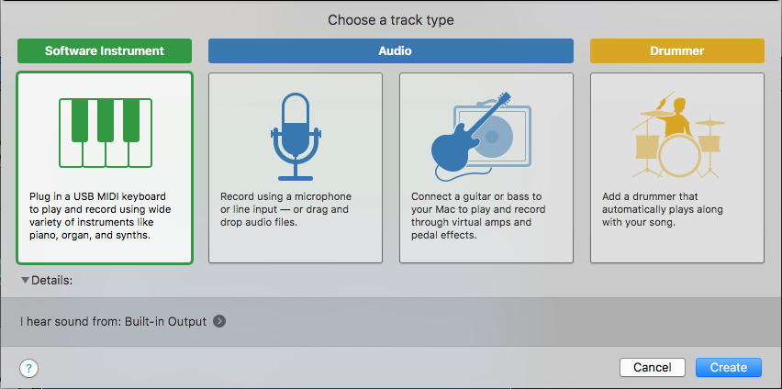
Using a Virtual Instrument
in GarageBand
Add a new track and
select “Software Instrument”

Slide 16
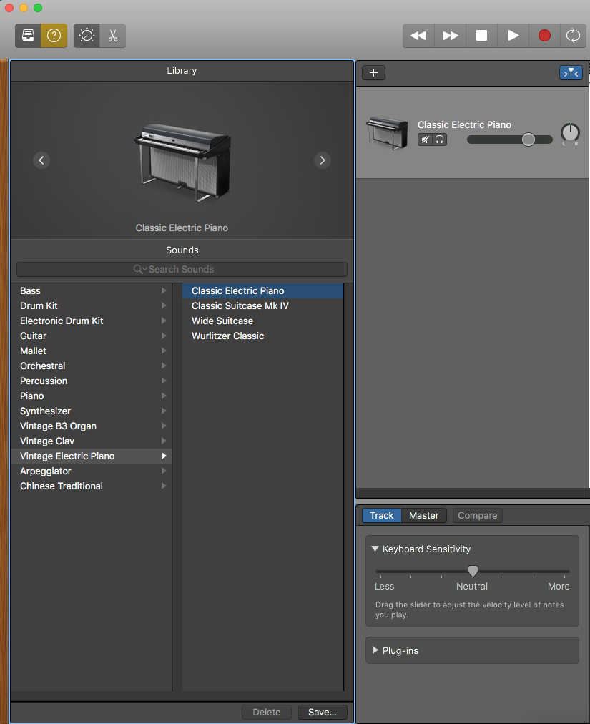
Click this icon to bring up the library
if it’s not open yet
This is where you select what instrument you want to use
This is where you control how much impact you want your keystrokes to have if you’re just using your computer keyboard

Slide 17
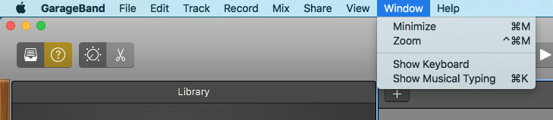
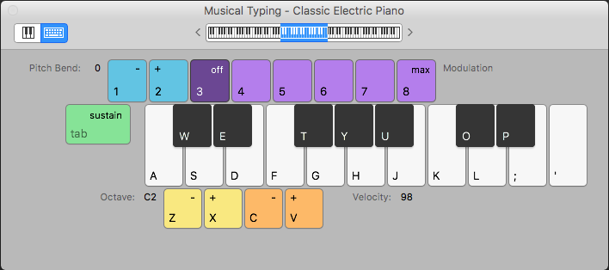
Choose Window > Show Musical Typing
This will bring up the Musical Typing interface that lets you use your computer keyboard to create music!
(Alternatively, you can use a MIDI keyboard to create)

Slide 18
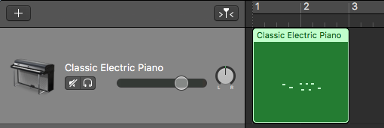
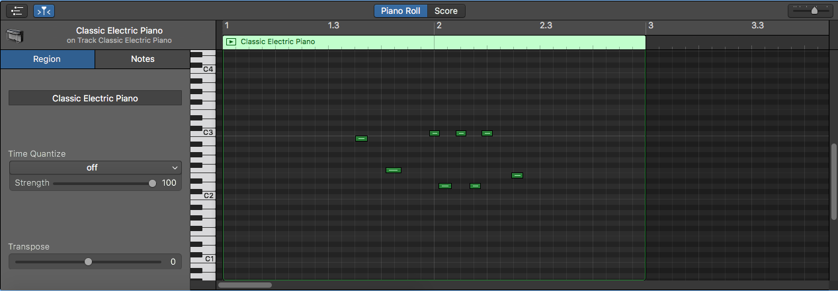
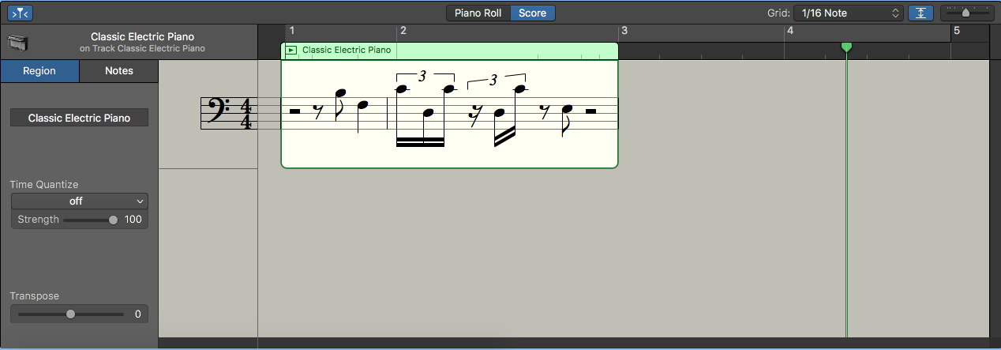
Hit record and start playing the keys
(you may want to use the
metronome function)
If you double-click the recorded section, you’ll bring up the piano roll.
Here you can interact with the individual notes by lengthening or shortening them. You can even change the note or remove it completely.
You can also click “Score” to bring the actual musical notation where you can interact with notes in the same way.

Slide 19
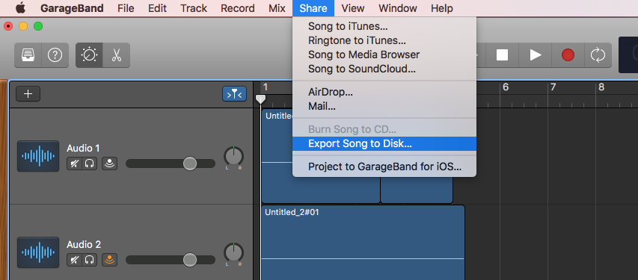
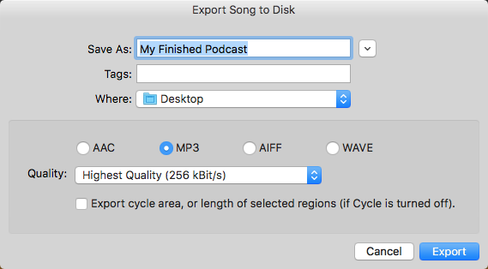
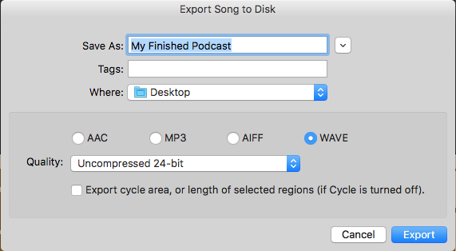
To export your final product,
click Share > Export Song to Disk…
In most cases, just choose MP3 at highest quality. This will result in high quality at a small, manageable file size.
For an uncompressed file, choose WAVE at 24-bit. This is the best choice for an archival backup.

